Slide 1
Cost Concepts
Reference: Brewer, P. C., Garrison, R. H., & Noreen, E. W. (2015). Managerial accounting. McGraw-Hill Education.
Source URL: http://3.droppdf.com/files/OYSmc/managerial-accounting-15th-edition.pdf
Activity-Based Costing: A Tool to Aid Decision Making by S.M. Shafiul Alam is licensed under a Creative Commons Attribution-ShareAlike 4.0 International License.

Slide 2
Cost Classifications for Assigning Costs to Cost Objects
A cost object is anything about which cost data are wanted –
  About products, customers, jobs etc.
Direct Cost
  A cost that can be straightforwardly and suitably traced to a stated cost object.
Indirect Cost
  An indirect cost is a cost that cannot be easily and conveniently drawn to a specified cost object.

Slide 3
Cost Classifications for Manufacturing Companies
Manufacturing Costs
  Direct materials
    materials that turn out to be an essential part of the finished product and the costs can be suitably traced to the finished product.
  Direct labor
    labor costs that can be easily (i.e., physically and conveniently) drawn to specific units of product.
  Manufacturing overhead
    manufacturing costs excluding direct materials and direct labor. Manufacturing overhead comprises items such as indirect materials; indirect labor; maintenance and repairs on production equipment etc.

Slide 4
Nonmanufacturing Costs
  Selling costs comprise all costs that are incurred to secure client orders and acquire the completed product to the client.
  Administrative costs comprise all costs related to overall management of an organization

Slide 5
Cost Classifications for Preparing Financial Statements
Product costs
  comprise all costs involved in obtaining or manufacturing a product. In the case of manufactured goods, these costs comprise direct materials, direct labor, and manufacturing overhead.
  recognized as inventoriable costs .
Period costs
  costs that are not product costs.
  All selling and administrative expenses

Slide 6
Prime cost
  the sum of direct materials cost and direct labor cost.
Conversion cost
  the sum of direct labor cost and manufacturing overhead cost.

Slide 7
Cost Classifications for Predicting Cost Behavior
A variable cost
  differs, in total, in direct ratio to changes in the level of activity.
Examples of variable costs include:
  cost of goods sold for a merchandising company, direct materials, direct labor, variable elements of manufacturing overhead, such as indirect materials, supplies, and power, and variable elements of selling and administrative expenses, such as commissions and shipping costs.
An activity base
  a measure of what causes the incurrence of a variable cost.
  sometimes recognized as a cost driver.

Slide 8
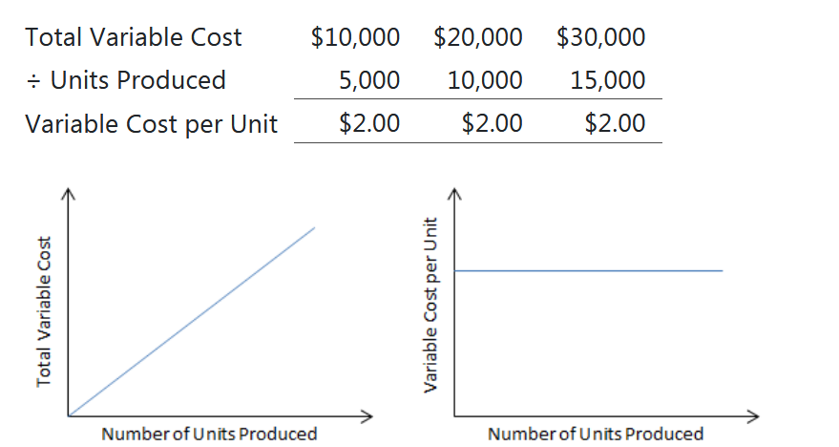
Cost Classifications for Predicting Cost Behavior

Slide 9
Fixed cost
  a cost that remains constant, in total, irrespective of changes in the level of activity.
  not affected by changes in activity
  Examples
    straight-line depreciation, insurance, property taxes, rent, supervisory salaries, administrative salaries, and advertising.
  Committed fixed costs
    organizational investments for a long period that can’t be considerably reduced even for short time period without making vital changes.
  Discretionary fixed costs
    usually ascend from annual decisions to spend on certain fixed cost

Slide 10
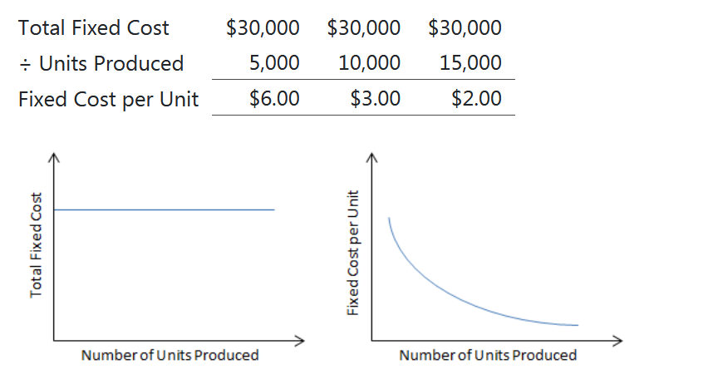
Cost Classifications for Predicting Cost Behavior

Slide 11
The Linearity Assumption and the Relevant Range
  Generally it is assumed that costs are firmly linear
    the association between cost and activity could be represented by a straight line relationship.
    Cost can be approximated in a narrow band of activity which is recognized as the relevant range by a straight line.
  Relevant range
    the range of activity within which the supposition that cost behavior is firmly linear is sensibly binding.
    Beyond the relevant range, a fixed cost and variable cost may no longer be strictly fixed or strictly variable respectively.

Slide 12
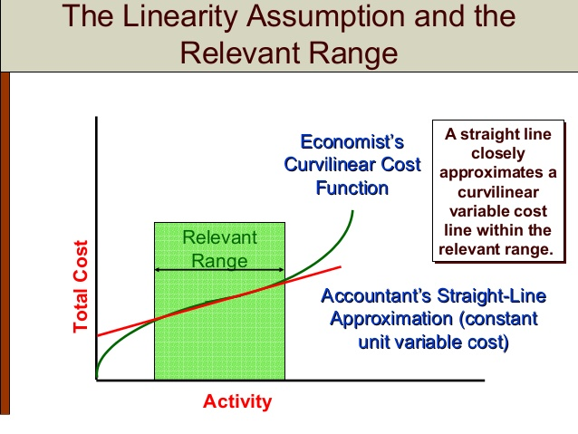
"Cost Behavior: Analysis and Use" by SlideShare is licensed under CC BY 4.0

Slide 13
A Mixed cost
  contains both variable and fixed cost elements.
  also identified as semi-variable costs.
Y = a + bX
    Y = The total mixed cost
    a = The total fixed cost (the vertical intercept of the line)
    b = The variable cost per unit of activity (the slope of the line)
    X = The level of activity

Slide 14
A number of methods can be used to estimate fixed and variable components:
  account analysis,
  the engineering approach,
  the high-low method, and
  least-squares regression analysis.

Slide 15
In account analysis
  an account is categorized as either variable or fixed grounded on the expert’s previous data of how the cost behaves.
The engineering approach
  includes a thorough investigation of what cost behavior is supposed to be, based on an industrial engineer’s assessment of the manufacturing methods to be utilized, the materials specifications, labor requirements, equipment usage, production efficiency, power consumption, and so on.
    The high-low
    least-squares regression methods

Slide 16
Traditional Income Statements
The Traditional Format Income Statement
  prepared primarily for outside reporting purposes.
  This format organizes costs into two groups
    cost of goods sold and
    selling and administrative expenses.

Slide 17
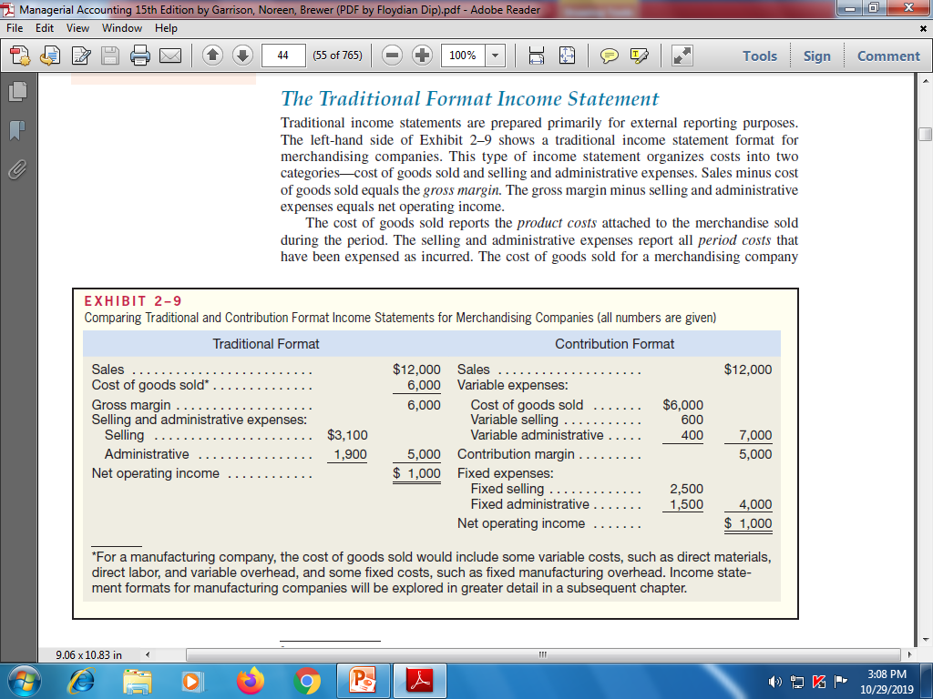
Traditional Income Statements

Slide 18
Contribution Format Income Statement
The Contribution Format Income Statement
The contribution format income statement is utilized as an internal planning and decision-making device.
Contribution margin
  The amount remaining from sales after variable expenses have been subtracted.
  This amount contributes for covering fixed expenses and then contributes to profits.

Slide 19
Cost Classifications for Decision Making
Differential cost
  A difference in costs between two alternatives
Differential revenue
  A difference in revenues between two alternatives
Opportunity cost
  Potential benefit given up when one alternative is chosen over another.
Sunk cost
  A cost that has already been acquired and cannot be altered by any choice made at present or in the future.

