Slide 1
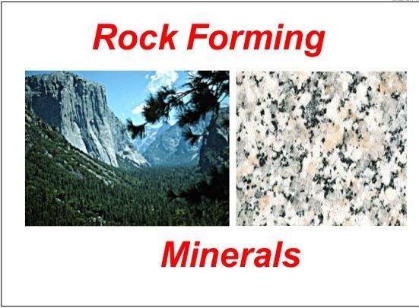


Slide 2
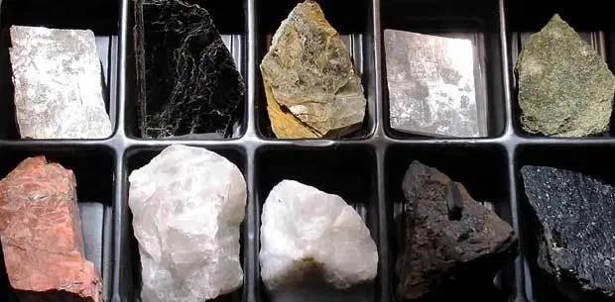
Minerals
These are naturally occurring inorganic solids with crystalline
structure, and chemical composition which may be fixed or vary within certain limits. A mineral has one specific chemical composition, whereas a rock can be an aggregate of different minerals or mineraloids. The study of minerals is called mineralogy.

Slide 3
They are considered natural because they are formed by natural geological
process.
Minerals are the building blocks of rocks
Minerals undergo different geological processes and become
part of or develop into rocks, in which case they become known as “rock-
forming minerals ”.

Slide 4
Minerals Groups

Slide 5
Difference Between Minerals and Rock
Minerals | Rocks
Pure(made of one substance) | More than one minerals
Some heavy crystals | Not single crystals
Usually Pretty | Not usually as pretty
Usually have a shape | No definite shape
Color is usually the same | Color is not the same
No fossils | Some heavy fossils

Slide 6
Physical Properties of Minerals
The Physical properties of minerals are used by Mineralogists to help determine the identity of a specimen. Some of the tests can be performed easily in the field, while others require laboratory equipment. For the beginning student of geology, there are a number of simple tests that can be used with a good degree of accuracy. The list of tests is in a suggested order, progressing from simple experimentation and observation to more complicated either in procedure or concept.
Properties of Minerals
The following physical properties of minerals can be easily used to identify a mineral:
1.Color 2.Streak 3.Hardness
Cleavage or Fracture
Crystalline Structure
Diaphaneity or Amount of Transparency 7.Tenacity
8.Magnetism 9.Luster 10.Odor 11.Taste
12.Specific Gravity

Slide 7
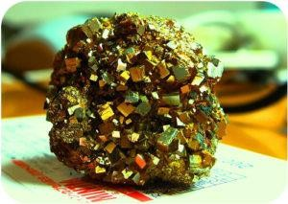
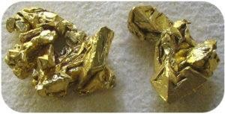
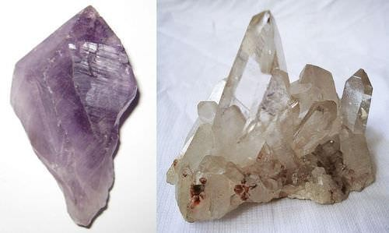
Color is often useful, but should not be relied upon. Different minerals may be the same color. Real gold, as seen in figure 2, is very similar in color to the pyrite in figure 1.
Additionally, Some minerals come in many different colors. Quartz, for example, may be clear, white, gray, brown, yellow, pink, red, or orange. So color can help, but do not rely on color as the determining property. Figure 3 shows one sample of quartz that is colorless and another quartz that is purple. A tiny amount of iron makes the quartz purple. Many minerals are colored by chemical impurities
Figure 1. This mineral has shiny, gold, cubic crystals with striations, so it is pyrite.
Figure 2. This mineral is shiny, very soft, heavy, and gold in color, and is actually gold
Figure 3. Purple quartz, known as amethyst, and clear quartz are the same mineral despite the different colors

Slide 8
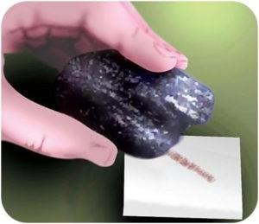
Streak is the color of a mineral’s powder. Streak is a more reliable property than color because streak does not vary. Minerals that are the same color may have a different colored streak. Many minerals, such as the quartz in the figure 3, do not have streak.
To check streak, scrape the mineral across an unglazed porcelain plate (Figure 4). Yellow-gold pyrite has a blackish streak, another indicator that pyrite is not gold, which has a golden yellow streak.
Figure 5. The streak of hematite across an unglazed porcelain plate is red-brown

Slide 9
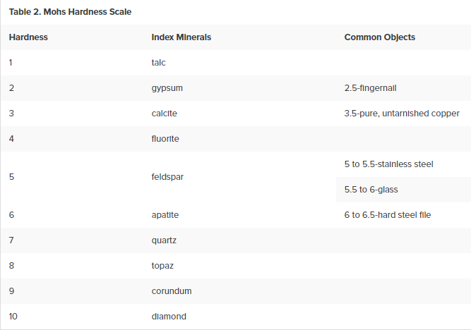
Hardness is the strength with which a mineral resists its surface being scraped or punctured. In working with hand samples without specialized tools, mineral hardness is specified by the Mohs hardness scale. The Mohs hardness scale is based 10 reference minerals, from talc the softest (Mohs hardness of 1), to diamond the hardest (Mohs hardness of 10). It is a relative, or nonlinear, scale. A hardness of 2.5 simply means that the mineral is harder than gypsum (Mohs hardness of 2) and softer than calcite (Mohs hardness of 3). To compare the hardness of two minerals see which mineral scratches the surface of the other.

Slide 10
With a Mohs scale, anyone can test an unknown mineral for its hardness. Imagine you have an unknown mineral. You find that it can scratch fluorite or even feldspar, but apatite scratches it. You know then that the mineral’s hardness is between 5 and
6. Note that no other mineral can scratch diamond

Slide 11
Cleavage and Fracture
Breaking a mineral breaks its chemical bonds. Since some bonds are weaker than other bonds, each type of mineral is likely to break where the bonds between the atoms are weaker. For that reason, minerals break apart in characteristic ways.
Cleavage is the tendency of a mineral to break along certain planes to make smooth surfaces. Halite breaks between layers of sodium and chlorine to form cubes with smooth surfaces (figure 6).
A mineral that naturally breaks into perfectly flat surfaces is exhibiting cleavage. Not all minerals have cleavage. A cleavage represents a direction of weakness in the crystal lattice. Cleavage surfaces can be distinguished by how they consistently reflect light, as if polished, smooth, and even. The cleavage properties of a mineral are described in terms of the number of cleavages and, if more than one cleavage, the angles between the cleavages. The number of cleavages is the number or directions in which the mineral cleaves. A mineral may exhibit 100 cleavage surfaces parallel to each other.
Those represent a single cleavage because the surfaces are all oriented in the same direction. The possible number of cleavages a mineral may have are 1,2,3,4, or 6. If more than 1 cleavage is present, and a device for measuring angles is not available, simply state whether the cleavages intersect at 90° or not 90°.

Slide 12
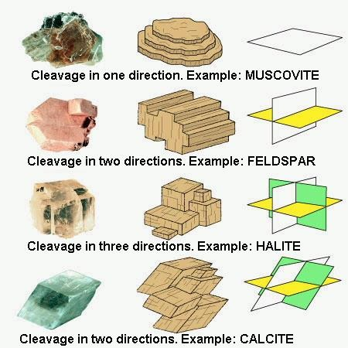
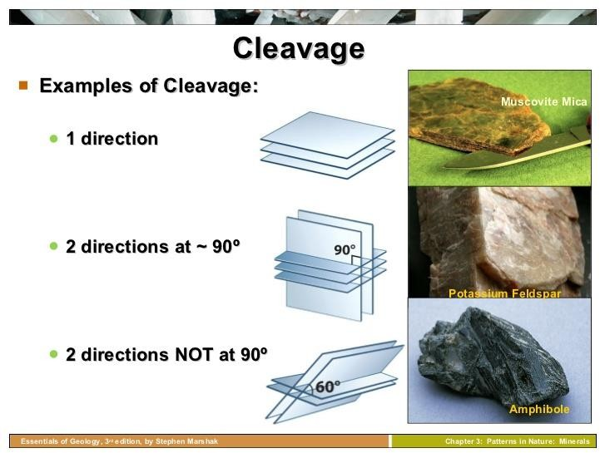

Slide 13
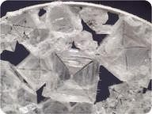
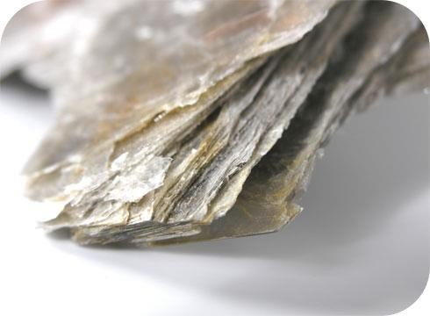
Figure 6. A close-up view of sodium chloride in a water bubble aboard the International Space Station.
Figure 7. Sheets of mica
To see mineral cleavage, hold the mineral up beneath a strong light and move it around, move it around some more, to see how the different sides reflect light. A cleavage direction will show up as a smooth, shiny, evenly bright sheen of light reflected by one set of parallel surfaces on the mineral.
Mica has cleavage in one direction and forms sheets (figure 7).

Slide 14
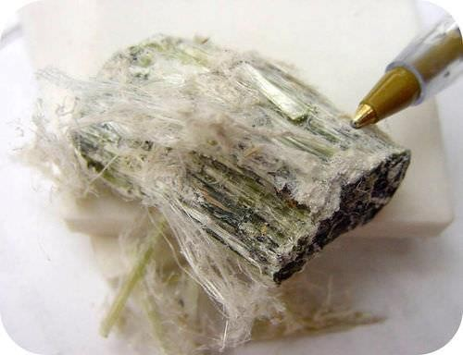
Fracture
Fracture is a break in a mineral that is not along a cleavage plane. Fracture is not always the same in the same mineral because fracture is not determined by the structure of the mineral.
Minerals may have characteristic fractures (figure 8). Metals usually fracture into jagged edges. If a mineral splinters like wood, it may be fibrous. Some minerals, such as quartz, form smooth curved surfaces when they fracture.
Figure 8. Chrysotile has splintery fracture.

Slide 15
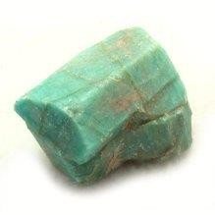
Crystalline Structure
Mineral crystals occur in various shapes and sizes. The particular shape is determined by the arrangement of the atoms, molecules or ions that make up the crystal and how they are joined. This is called the crystal lattice. There are degrees of crystalline structure, in which the fibers of the crystal become increasingly difficult or impossible to see with the naked eye or the use of a hand lens. Microcrystalline and cryptocrystalline structures can only be viewed using high magnification. If there is no crystalline structure, it is called amorphous. However, there are very few amorphous crystals and these are only observed under extremely high magnification.

Slide 16
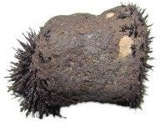
Transparency or Diaphaneity
Diaphaneity is a mineral’s degree of transparency or ability to allow light to pass through
it. The degree of transparency may also depend on the thickness of the mineral.
Magnetism
Magnetism is the characteristic that allows a mineral to attract or repel other magnetic materials. It can be difficult to determine the differences between the various types of magnetism, but it is worth knowing that there are distinctions made.

Slide 17
Luster
Luster describes the reflection of light off a mineral’s surface. Mineralogists have special terms to describe luster. One simple way to classify luster is based on whether the mineral is metallic or non-metallic. Minerals that are opaque and shiny, such as pyrite, have a metallic luster. Minerals such as quartz have a non-metallic luster.
Luster is how the surface of a mineral reflects light. It is not the same thing as color, so it crucial to distinguish luster from color. For example, a mineral described as “shiny yellow” is being described in terms of luster (“shiny”) and color (“yellow”), which are two different physical properties. Standard names for luster include metallic, glassy, pearly, silky, greasy, and dull. It is often useful to first determine if a mineral has a metallic luster. A metallic luster means shiny like polished metal. For example cleaned polished pieces of chrome, steel, titanium, copper, and brass all exhibit metallic luster as do many other minerals. Of the nonmetallic lusters, glassy is the most common and means the surface of the mineral reflects light like glass. Pearly luster is important in identifying the feldspars, which are the most common type of mineral. Pearly luster refers to a subtle irridescence or color play in the reflected light, same way pearls reflect light. Silky means relecting light with a silk-like sheen. Greasy luster looks similar to the luster of solidified bacon grease. Minerals with dull luster reflect very little light. Identifying luster takes a little practice. Remember to distinguish luster from color.

Slide 18
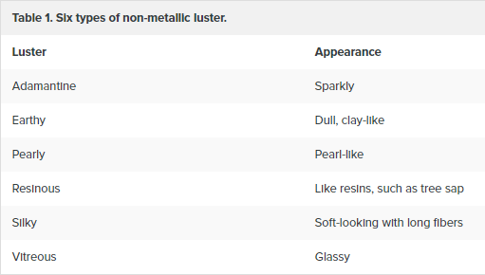
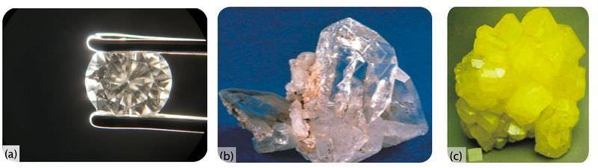
Different types of non-metallic luster are described in following table
(a) Diamond has an adamantine luster. (b) Quartz is not sparkly and has a vitreous, or glassy, luster. (c) Sulfur reflects less light than quartz, so it has a resinous luster.

Slide 19
Odor
Most minerals have no odor unless they are acted upon in one of the following ways:
moistened, heated, breathed upon, or rubbed.
Taste
Only soluble minerals have a taste, but it is very important that minerals not be placed in the mouth or on the tongue. You should not test for this property in the classroom.
Specific Gravity
Specific Gravity of a mineral is a comparison or ratio of the weight of the mineral to the weight of an equal amount of water. The weight of the equal amount of water is found by finding the difference between the weight of the mineral in air and the weight of the mineral in water.
Knowing the properties of minerals will help you to identify minerals in the field

