Slide 1

In the longitudinal profile of a stream, the distances of two points of elevation of 5 ft and 150 ft from source are 550 miles and 50 miles respectively. Calculate i) Integral constant, ii) Proportionality constant, iii) Elevation of source, iv) Elevation of the point at 100 miles from source and v) Distance between the points of elevation of 10 ft and 95 ft

Slide 2
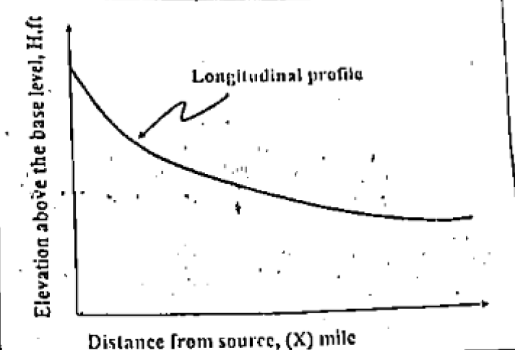
In the longitudinal profile of a stream, the distances of two points of elevation of 5 ft and 150 ft from source are 550 miles and 50 miles respectively. Calculate i) Integral constant, ii) Proportionality constant, iii) Elevation of source, iv) Elevation of the point at 100 miles from source and v) Distance between the points of elevation of 10 ft and 95 ft
150ft.
5ft.
50 miles
550 miles

Slide 3

Equation of a longitudinal profile of a stream is: H/C$=e^{−bX}$
(i) Finding Proportionality Constant,
From the equation we can write,
5/C$=e^{−b∗550}$……………….(i)
150/C$=e^{−b∗50}$……………...(ii)
Equation (i) divide by (ii) we get,
(5/C)/ (150/C) $=e^{−b∗550}/e^{−b∗50}$
b=

Slide 4
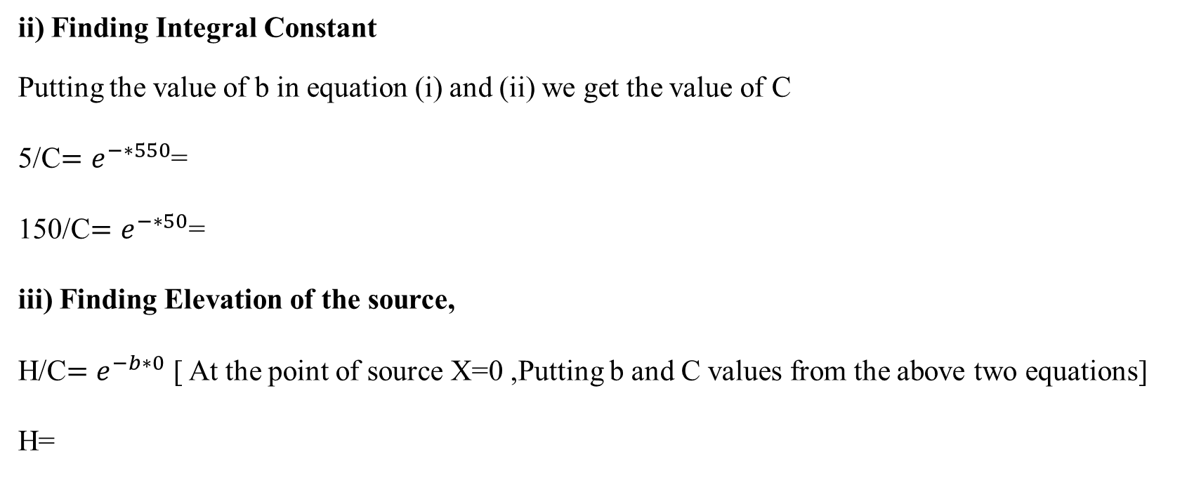
ii) Finding Integral Constant
Putting the value of b in equation (i) and (ii) we get the value of C
5/C$=e^{−∗550}$=
150/C$=e^{−∗50}$=
iii) Finding Elevation of the source,
H/C$=e^{−b∗0}$ [ At the point of source X=0 ,Putting b and C values from the above two equations]
H=

