Slide 1
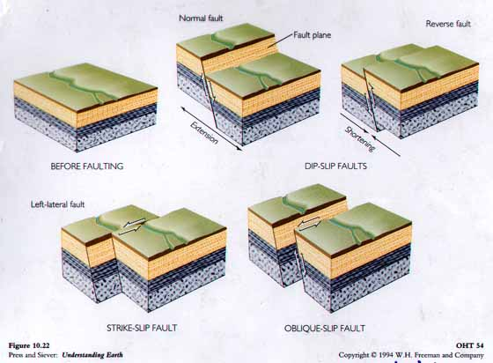

FAULT CLASSIFICATION AND TERMINALOGY
Faults: Are fractures that have appreciable movement parallel to their plane. They produced usually be seismic activity.
Understanding faults is useful in design for long-term stability of dams, bridges, buildings and power plants. The study of fault helps understand mountain building.
Faults may be hundred of meters or a few centimeters in length. Their outcrop may have as knife-sharp edges or fault shear zone. Fault shear zones may consist of a serious of interleaving anastomosing brittle faults and crushed rock or of ductile shear zones composed of mylonitic rocks

Slide 2
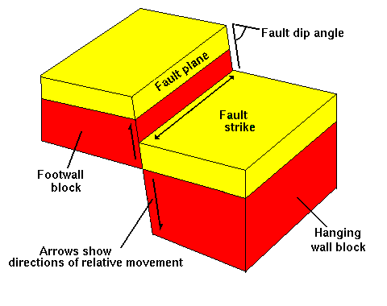
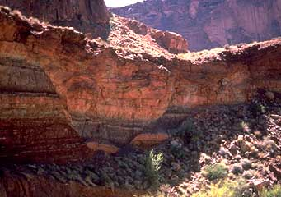
Parts of the Fault
Fault plane: Surface that the movement has taken place within the fault.On this surface the dip and strike of the fault is measured.
Hanging wall: The rock mass resting on the fault plane.
Footwall: The rock mass beneath the fault plane.
Slip: Describes the movement parallel to the fault plane.
Dip slip: Describes the up and down movement parallel to the dip direction of the fault.
Strike slip: Applies where movement is parallel to strike of the fault plane.
Oblique slip: Is a combination of strike slip and dip slip.
Net slip (true displacement): Is the total amount of motion measured parallel to the direction of motion

Slide 3
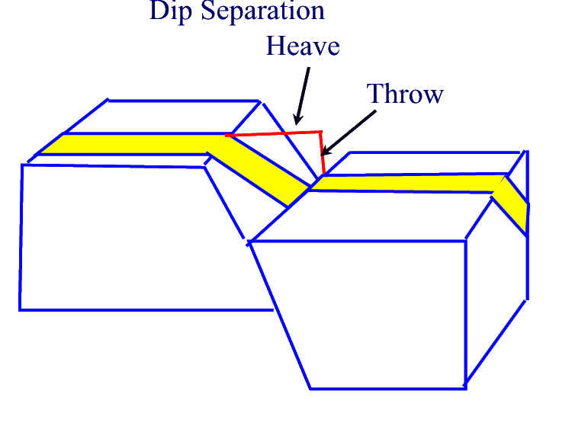
Separation: The amount op apparent offset of a faulted surface, measured in specified direction. There are strike separation, dip separation, and net separation.
Heave: The horizontal component of dip separation measured perpendicular to strike of the fault.
Throw: The vertical component measured in vertical plane containing the dip.

Slide 4
ANDERSON FAULTS CLASSIFICATION
Anderson (1942) defined three types of faults:
Normal Faults
Thrust Faults
Wrench Faults (strike slip)

Slide 5
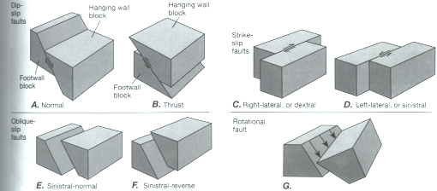
Faults Types

Slide 6
Normal Fault
Normal Fault: The hanging wall has moved down relative to the footwall.
Graben: consists of a block that has dropped down between two subparllel normal faults that dip towards each other.
Horst : consists of two subparallel normal faults that dip away from each other so that the block between the two faults remains high.
Listric: are normal faults that frequently exhibit (concave-up) geometry so that they exhibit steep dip near surface and flatten with depth.

Slide 7
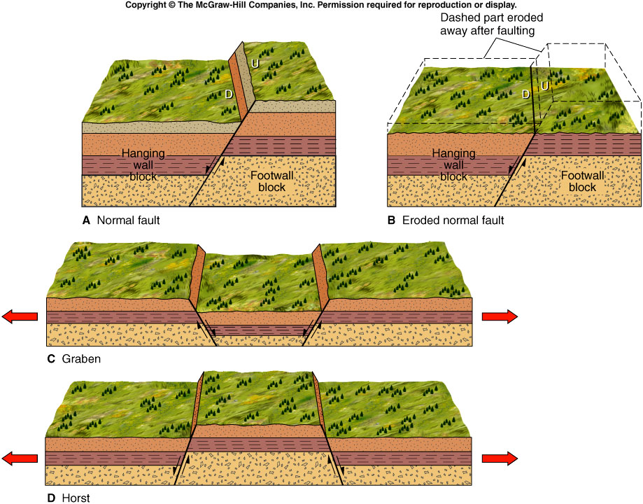

Slide 8
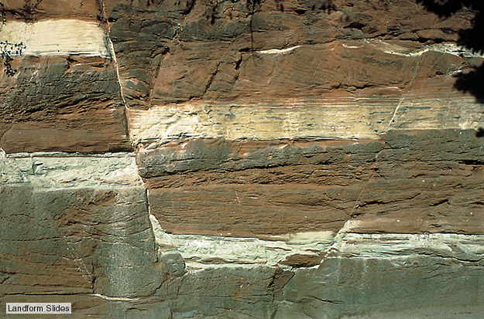
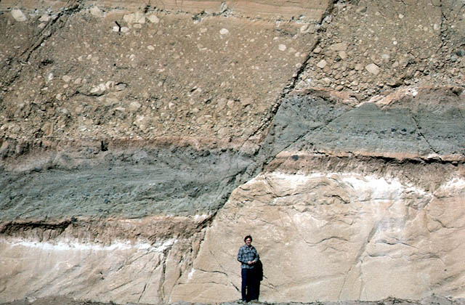
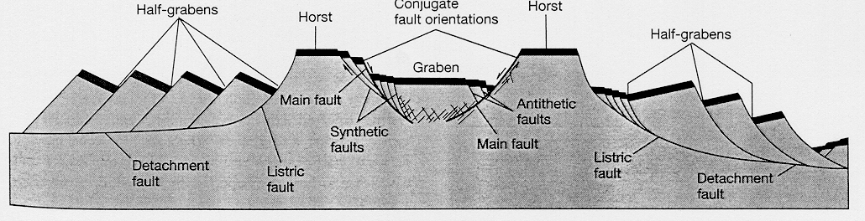
Normal Faults

Slide 9
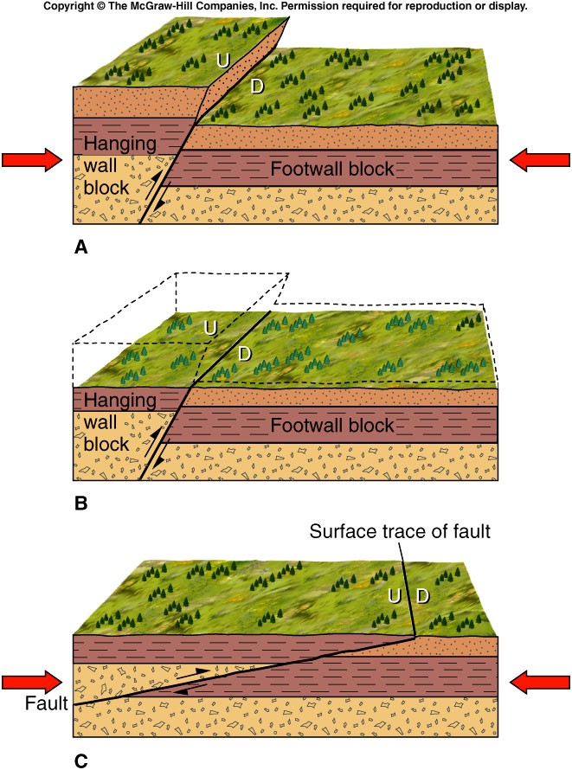
Thrust Fault
Thrust Faults: In the thrust faults the hanging wall has moved up relative to the footwall (dip angle 30º or less)
Reverse Faults: Are similar to the thrust faults regarding the sense of motion but the dip angle of the fault plane is 45º or more
Thrust faults usually formed in areas of comperssional regime

Slide 10
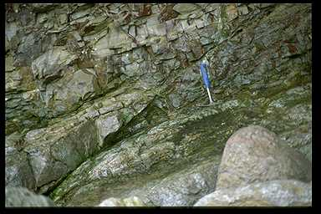
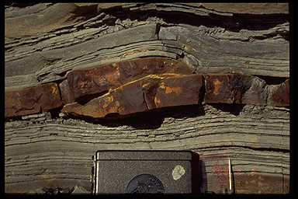
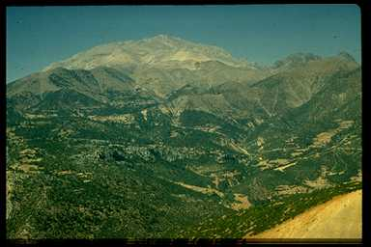
Thrust Faults

Slide 11
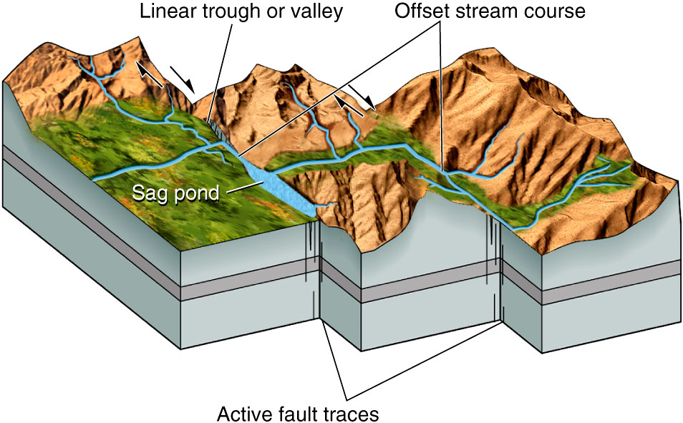
Strike-Slip Fault
Strike-slip Faults: Are faults that have movement along strikes.
There are two types of strike slip faults:
A] Right lateral strike-slip fault (dextral): Where the side opposite the observer moves to the right.
B] Left lateral strike-slip fault (sinistral): Where the side opposite the observer moves to the left.
Note that the same sense of movement will also be observed from the other side of the fault.

Slide 12

Transform Faults
Transform Faults: Are a type of strike-slip fault (defined by Wilson 1965). They form due to the differences in motion between lithospheric plates. They are basically occur where type of plate boundary is transformed into another.
Main types of transform faults are:
Ridge-Ridge
Ridge-Arc
Arc-Arc

Slide 13
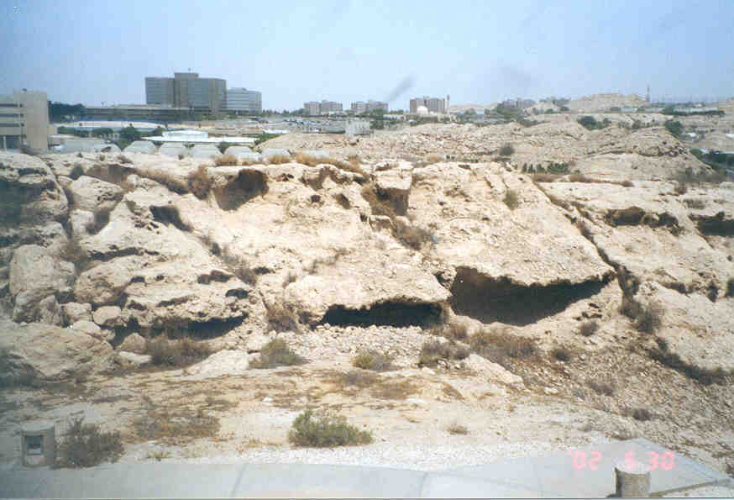
FRACTURE
FRACTURE: is defined by Twiss and Moores (1992) as “..surfaces along which rocks or minerals have broken; they are therefore surfaces across which the material has lost cohesion”
Characteristics of fractures according to Pollard and Aydin (1988)
fractures have two parallel surfaces that meet at the fracture front
these surfaces are approximately planar
the relative displacement of originally adjacent points across the fractures is small compared to the fracture length..

Slide 14
Fracture, Joint
The term fracture encompasses both joints and faults.
JOINTS: are fractures along which there has been no appreciable displacement parallel to the fracture and only slight movement normal to the fracture plane.
Joints are most common of all structures present in all settings in all kind of rocks as well as consolidated and unconsolidated sediment

Slide 15
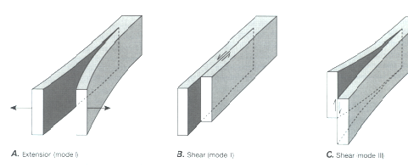
Types of Fractures
Extensional Fracture
In extensional fractures the Fracture plane is oriented parallel to σ1 and σ 2 and perpendicular to σ 3.
Three types of fractures have been identified:
Mode I fractures (joints) it is the extensional fractures and formed by opening with no displacement parallel to the fracture surface (see above figure).
Mode II and Mode III are shear fractures. These are faults like fractures one of them is strike -slip and the other is dip-slip
Same fracture can exhibit both mode II and mode III in different parts of the region.

Slide 16
Importance of studying joints and shear fractures
To understand the nature and sequence of deformation in an area.
To find out relationship between joints and faults and or folds.
Help to find out the brittle deformation in an area of construction (dams, bridges, and power plants.
In mineral exploration to find out the trend and type of fractures and joints that host mineralization which will help in exploration.

