Slide 1

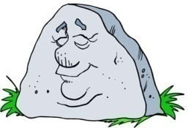
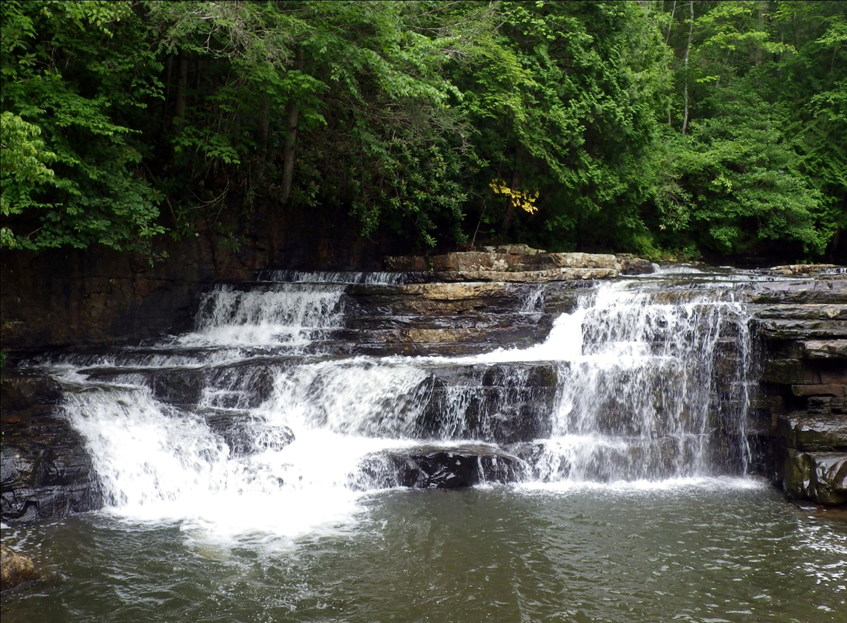

METAMORPHIC ROCK

Slide 2
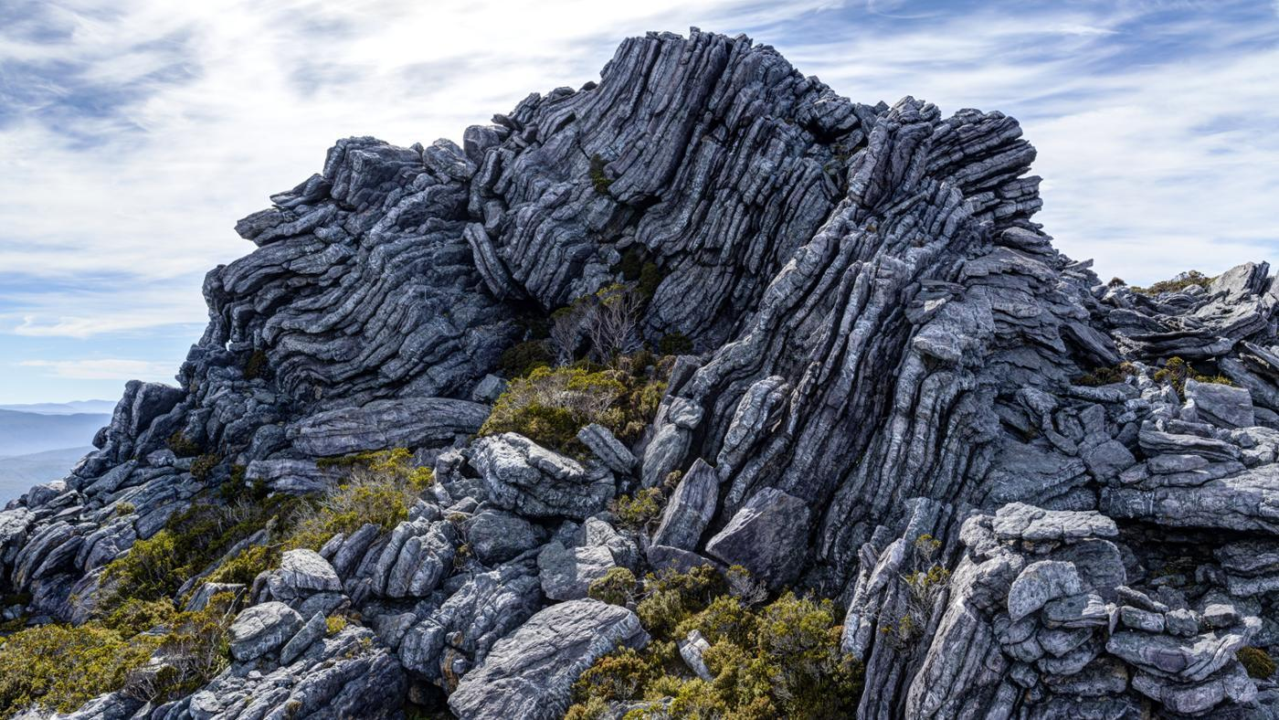
Metamorphic Rock
The term "metamorphic" means "to change form."
Any rock (igneous, sedimentary, or metamorphic) can become a metamorphic rock. If rocks are buried deep in the Earth at high temperatures and pressures, they form new minerals and textures all without melting. If melting occurs, magma is formed, starting the rock cycle all over again.

Slide 3
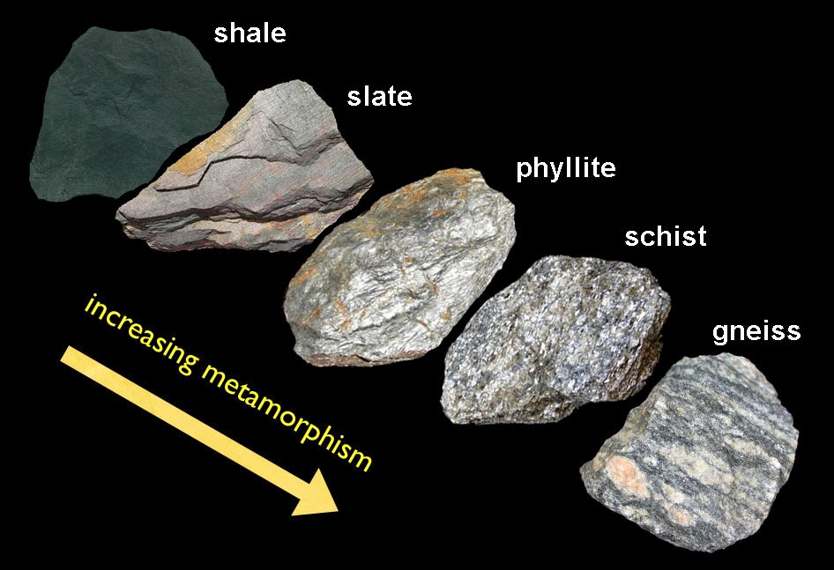
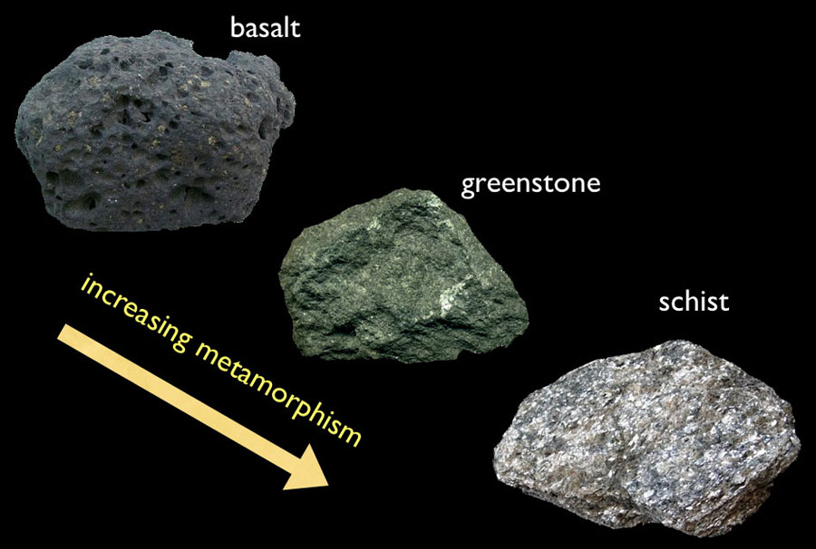
Metamorphism
The word "Metamorphism" comes from the Greek: Meta = change, Morph = form, so
metamorphism means to change form. In geology this refers to the changes in mineral
assemblage and texture that result from subjecting a rock to pressures and temperatures
different from those under which the rock originally formed.
The original rock that has undergone metamorphism is called the protolith.

Slide 4
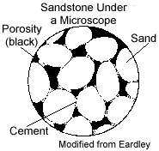
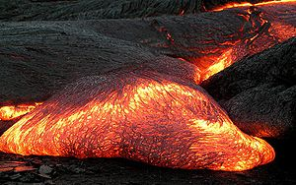
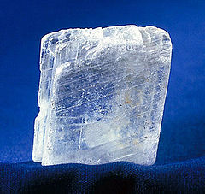
Agents of Metamorphism
There are three main sources of chemically active fluids:
• pore waters of sedimentary rocks,
• fluids from cooling magma,
• water from dehydration of water-bearing minerals like gypsum (CaSO4 . 2H2O)

Slide 5
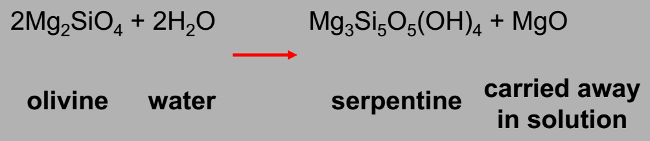
Pore fluids
• As well as transporting material pore fluids act as a reservoir
• As pressure and temperature increase material is transferred from the fluid to the minerals and vice versa
• In this way fluids serve to catalyse the reactions
• Metamorphism will drive fluids out of hydrous minerals forming veins
The Role of Fluids
• An example of metamorphism by fluid activity is seawater moving through the hot basalt of the oceanic crust. Olivine in the basalt is transformed to the mineral serpentine.

Slide 6
Factors Controlling Metamorphism
Metamorphism occurs because rocks undergo changes in temperature and pressure and may be subjected to differential stress and hydrothermal fluids. Metamorphism occurs because some minerals are stable only under certain conditions of pressure and temperature. When pressure and temperature change, chemical reactions occur to cause the minerals in the rock to change to an assemblage that is stable at the new pressure and temperature conditions. But, the process is complicated by such things as how the pressure is applied, the time over which the rock is subjected to the higher pressure and temperature, and whether or not there is a fluid phase present during metamorphism.
So that The following are the factors that control metamorphism:
  Pressure
  Temperature
  Fluid phase
  Time

Slide 7
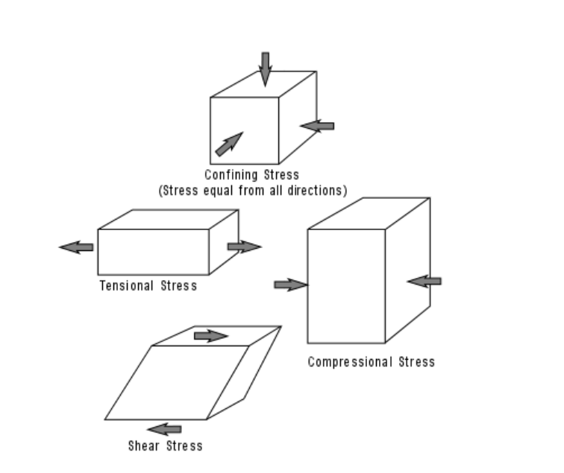
  Pressure
Pressure increases with depth of burial, thus, both pressure and temperature will vary
with depth in the Earth. Pressure is defined as a force acting equally from all directions. It is a type of stress, called hydrostatic stress, or uniform stress.
If the stress is not equal from all directions, then the stress is called a differential stress.
high pressures cause minerals with ‘open’ lattices to collapse, forming more dense crystals. Most metamorphic rocks form at 40-100 km depth where pressures are 10,000-30,000 times greater than the surface of the Earth

Slide 8
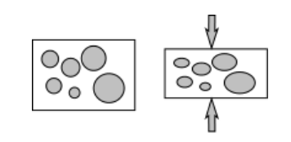
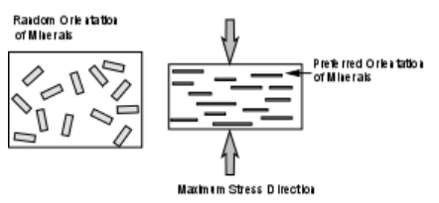
There are two kinds of differential stress. Normal stress causes objects to be compressed
in the direction of maximum principal stress and extended in the direction of minimal
stress. If differential stress is present during metamorphism, it can have a profound
effect on the texture of the rock. Shear stress causes objects to be smeared out in the
direction of applied stress.
Differential stress if acting on a rocks can have a profound affect on the appearance or
texture of the rock.
Rounded grains can become flattened in the direction of maximum stress.
Minerals that crystallize or grow in the differential stress field can have a preferred orientation. This is especially true of the sheet silicate minerals (the micas: biotite and muscovite, chlorite, talc, and serpentine).
These sheet silicates will grow with their sheets orientated perpendicular to the direction
of maximum stress. Preferred orientation of sheet silicates causes rocks to be easily
broken along approximately parallel sheets. Such a structure is called a foliation.

Slide 9
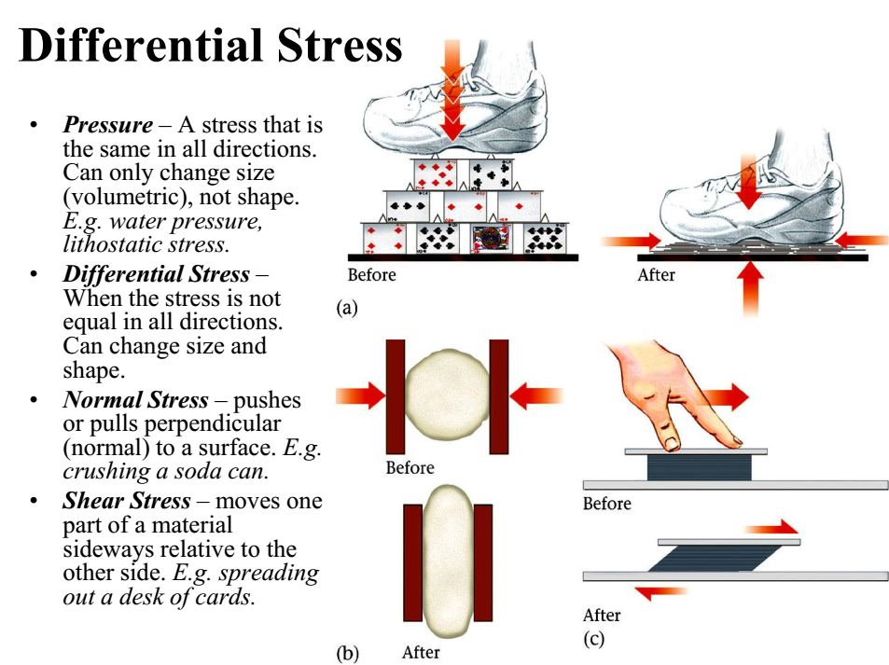

Slide 10
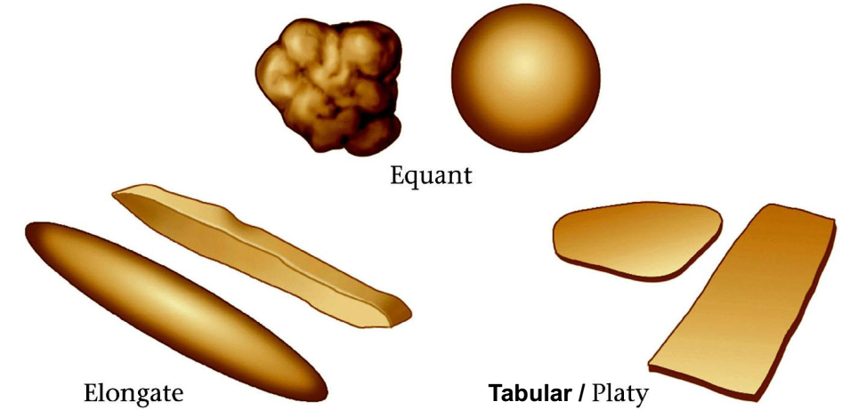
Changes in Shape due to Differential Stress
• Differential stresses may cause once equant (~same length in all dimensions) to become elongate or tabular/platy in shape.
• The preferred orientation of these inequant grains gives the rock a foliation (a planar fabric)

Slide 11
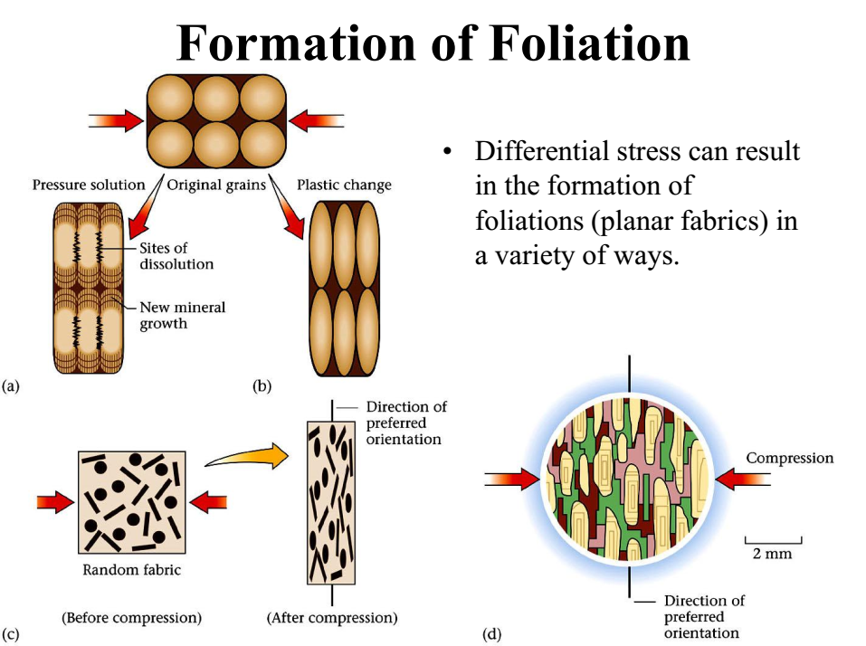
Formation of Foliation

Slide 12
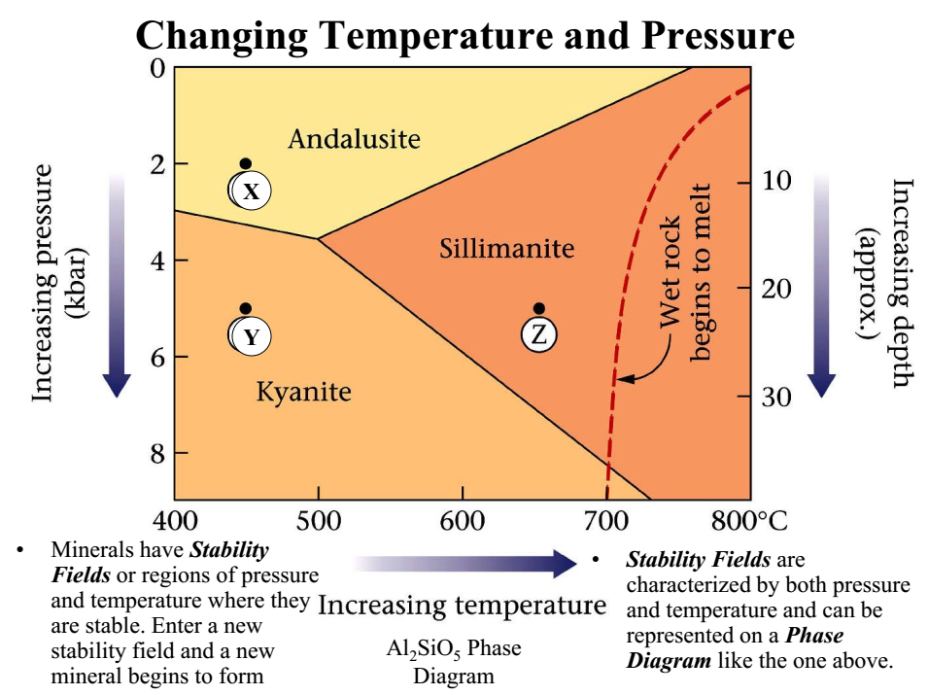
Changing Temperature and Pressure

Slide 13
Temperature
Temperature increases with depth in the Earth along the Geothermal Gradient.
Thus higher temperature can occur by burial of rock.
Heat increases the rate of the chemical reactions that yield new minerals as parent
rocks are metamorphosed.
The heat may come from magma intrusion or deep burial via subduction at convergent boundaries.
In country rock surrounding a magma body, heat’s effect decreases with distance from the magma body.

Slide 14
Fluid Phase
Any existing open space between mineral grains in a rock can potentially
contain a fluid. This fluid is mostly H2O, but contains dissolved ions. The fluid phase is important because chemical reactions that involve changing a solid mineral into a new solid mineral can be greatly speeded up by having dissolved ions transported by the fluid. If chemical alteration of the rock takes place as a result of these fluids, the process is called metasomatism.

Slide 15
The Role of Hydrothermal Fluids
• Hydrothermal fluids - Include hot water, steam, and supercritical fluid.
Hydrothermal fluids are chemically-active in that they are able to dissolve certain
minerals, so hydrothermal fluids are solutions, not just water.
• Supercritical Fluid – A substance that forms under high temps and pressures that
has properties of both a gas and a liquid. Supercritical fluids permeate rocks like a
gas and react with minerals like a fluid.
• Where does this fluid come from?
1- groundwater that percolates downward.
2- water and volatiles released from magma
3- water is released during some metamorphic reactions
• Hydrothermal fluids speed metamorphic reactions because fluids allow for easy
transport of ions and fluids are consumed in some reactions

Slide 16
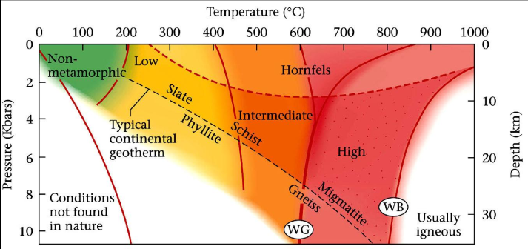
Grade of Metamorphism
Metamorphic grade is a general term for describing the relative temperature and
pressure conditions under which metamorphic rocks form.
• Low-Grade – rocks that form under low temperatures (200-320o C)
• Intermediate-Grade – rocks that form under temperatures (320-600o C)
• High-Grade – rocks that form above ~600o C.

Slide 17
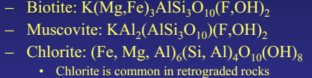
Prograde & Retrograde Metamorphism
Prograde Metamorphism – Metamorphism that occurs while temp and pressure progressively increase. They form minerals that are stable at higher temp and pressure. Neocrystallization commonly releases water in the host rock, so high grade rocks tend to be drier (little no OH-) than low grade rocks. So, schist loses its schistosity at high grades and may form gneiss.
Retrograde Metamorphism – Metamorphism that occurs when temp and pressure decreases. For metamorphic reactions to occur in these conditions, water must be added to the rock (hydrothermal fluids). Without water, high grade rocks cannot be retrograded. This is why very old (billions of years) high grade rocks are exposed at the surface of the Earth in certain places.

Slide 18
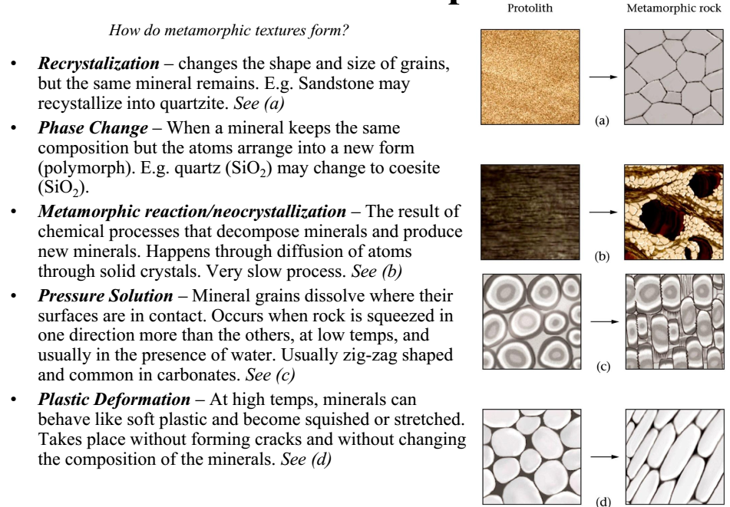
Formation of Metamorphic Textures

Slide 19
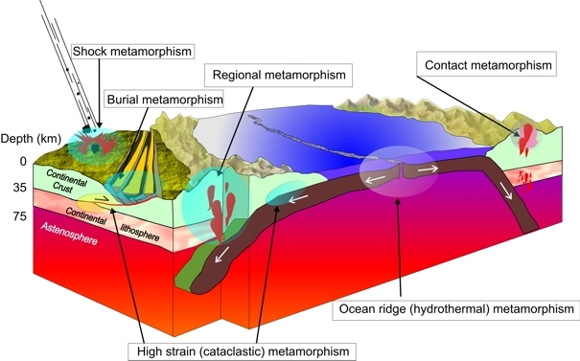
Types of Metamorphism
Metamorphism can take place in several different environments where special conditions exist in terms of pressure, temperature, stress, conditions, or chemical environments. We here describe several diffrent types of metamorphism that are recognized.
Contact Metamorphism
Burial Metamorphism
Dynamic Metamorphism
Regional Metamorphism
Hydrothermal Metamorphism
Subduction Related Metamorphism
Shock Metamorphism

Slide 20
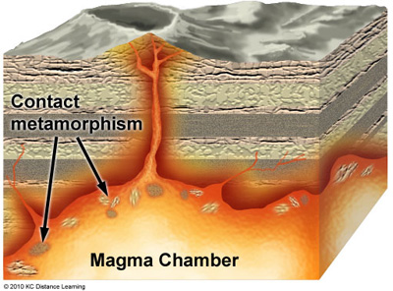
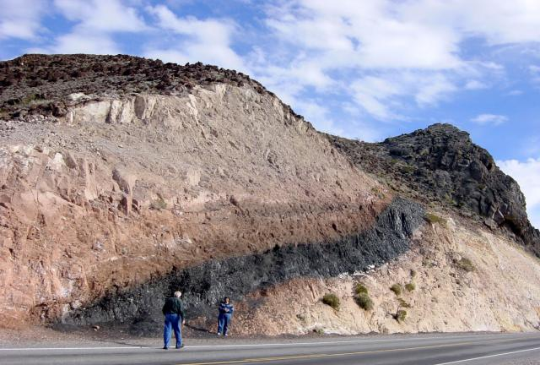
Contact Metamorphism (also called thermal metamorphism) - Occurs adjacent to
igneous intrusions and results from high temperatures associated with the igneous
intrusion. Since only a small area surrounding the intrusion is heated by the magma,
metamorphism is restricted to a zone surrounding the intrusion, called a metamorphic
aureole. Outside of the contact aureole, the rocks are unmetamorphosed. The grade of
metamorphism increases in all directions toward the intrusion. Because temperature
differences between the surrounding rock and the intruded magma are larger at shallow
levels in the crust, contact metamorphism is usually referred to as high temperature, low
pressure metamorphism. The rock produced is often a fine-grained rock that shows no
foliation, called a hornfels.

Slide 21
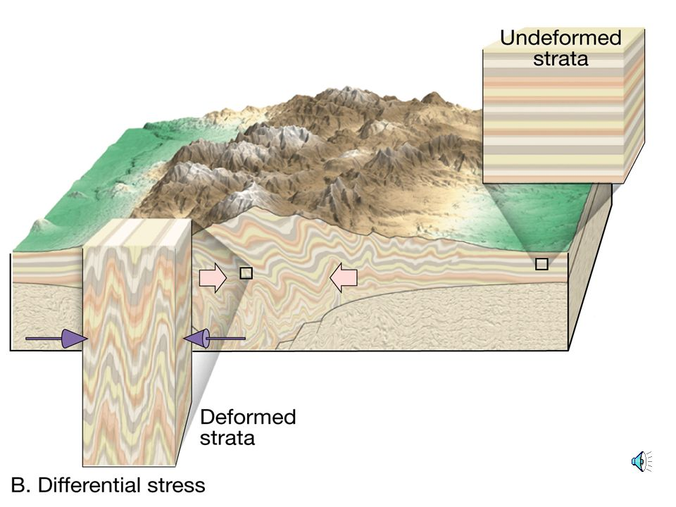
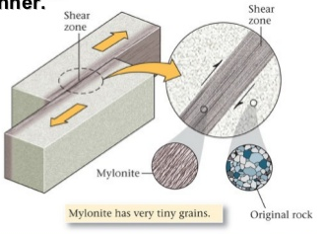
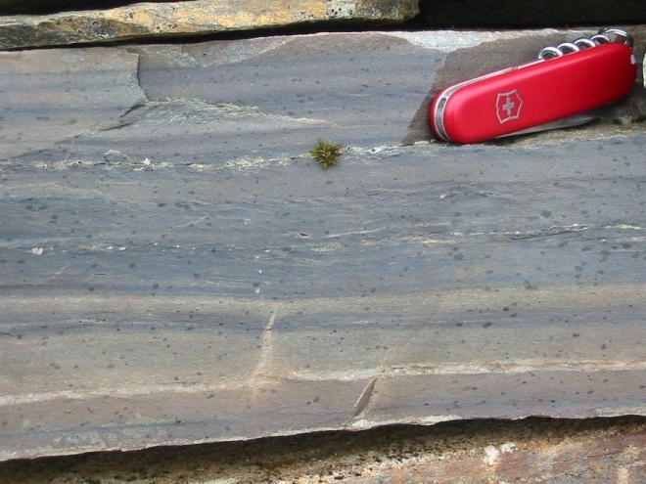
Burial Metamorphism - When sedimentary rocks are buried to depths of several hundred meters, temperatures greater than 300oC may develop in the absence of differential stress. New minerals grow, but the rock does not appear to be metamorphosed. The main minerals produced are the Zeolites. Burial metamorphism overlaps, to some extent, with diagenesis, and grades into regional metamorphism as temperature and pressure increase.
Dynamic Metamorphism - This type of metamorphism is due to mechanical
deformation, like when two bodies of rock slide past one another along a fault zone.
Heat is generated by the friction of sliding along the zone, and the rocks tend to crushed
and pulverized due to the sliding. Dynamic metamorphism is not very common and is
restricted to a narrow zone along which the sliding occurred. The rock that is produced
is called a mylonite.

Slide 22
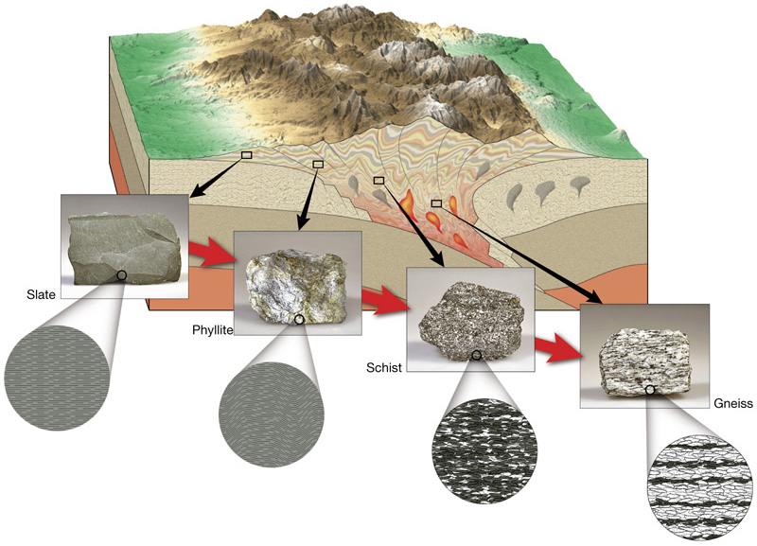
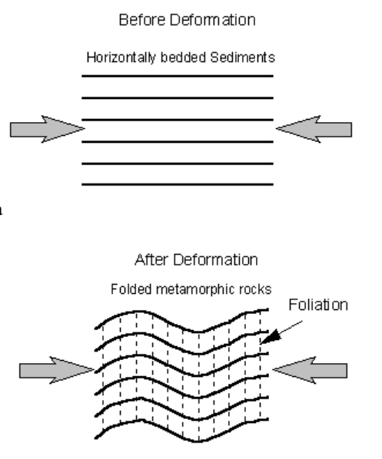
Regional Metamorphism - This type of metamorphism occurs over large areas that were subjected to high degrees of deformation under differential stress. Thus, it usually results in forming metamorphic rocks that are strongly foliated, such as slates, schists, and
gneisses. The differential stress usually results from tectonic forces that produce a compression of the rocks, such as when two continental masses collide with one another. Thus, regionally metamorphosed rocks occur in the cores of mountain ranges or in eroded mountain ranges. Compressive stresses result in folding of the rock, as shown here, and results in thickening of the crust which tends to push rocks down to deeper levels where
they are subjected to higher temperatures and pressures.

Slide 23
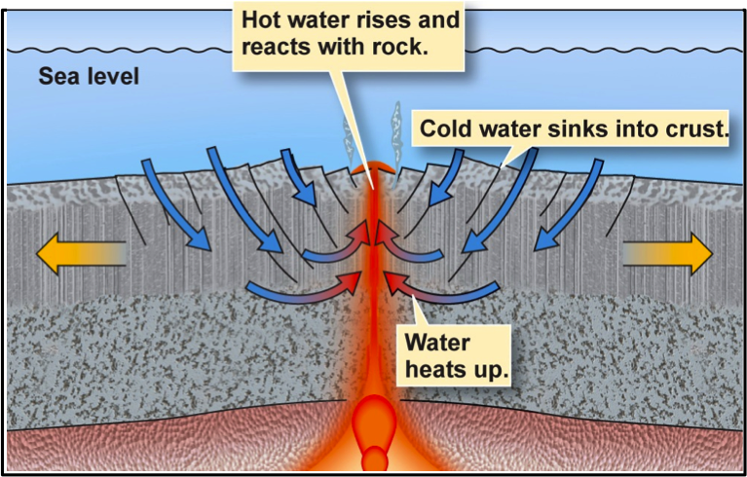
Hydrothermal Metamorphism - Near oceanic ridges where the oceanic crust is broken up by extensional faults, sea water can descend along the cracks. Since oceanic ridges are areas where new oceanic crust is created by intrusion and eruption of basaltic magmas, these waterrich fluids are heated by the hot crust or magma and become hydrothermal fluids. The hydrothermal fluids alter the basaltic oceanic crust by producing hydrous minerals like chlorite and talc. Because chlorite is a green colored mineral the rocks hydrothermal metamorphic rocks are also green and often called greenstones.
Subduction Related Metamorphism - At a subduction zone, the oceanic crust is pushed downward resulting in the basaltic crust and ocean floor sediment being subjected to relatively high pressure. But, because the oceanic crust by the time it subducts is relatively cool, the temperatures in the crust are relatively low. Under the conditions of low temperature and high pressure, metamorphism produces an unusual blue mineral, glaucophane. Compressional stresses acting in the subduction zone create the differential stress necessary to form schists and thus the resulting metamorphic rocks are called blueschist

Slide 24
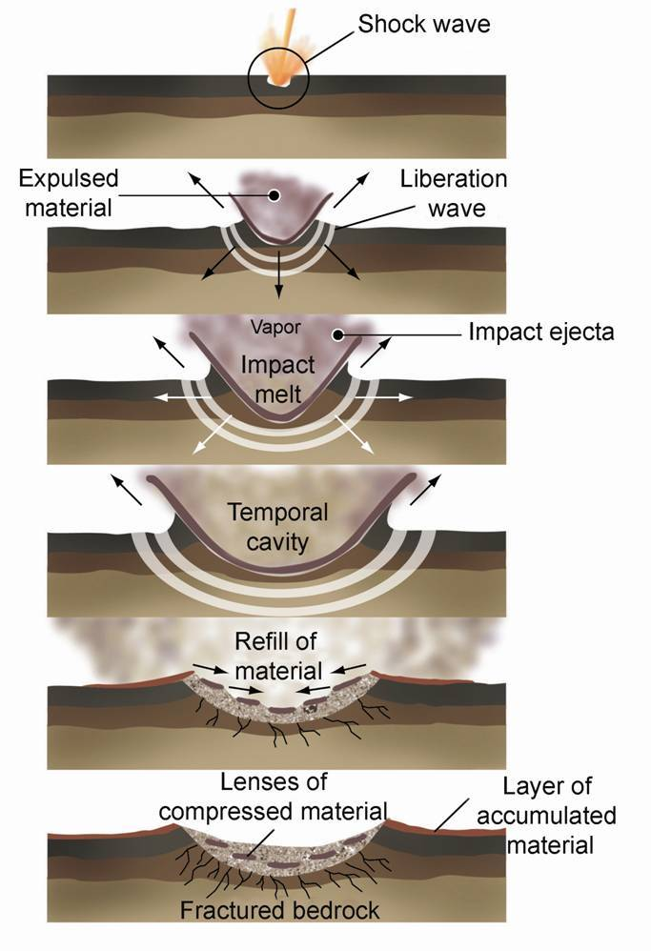
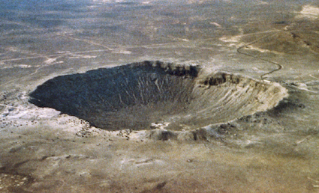
Shock Metamorphism - When a large meteorite collides with the Earth, the kinetic energy is converted to heat and a high pressure shock wave that propagates into the rock at the impact site. The heat may be enough to raise the temperature to the melting temperature of the earth rock. The shock wave produces high enough pressure to cause quartz to change its crystal structure to more a dense polymorph like coesite or stishovite. Ancient meteorite impact sites have been discovered on the basis of finding this evidence of shock metamorphism.

Slide 25
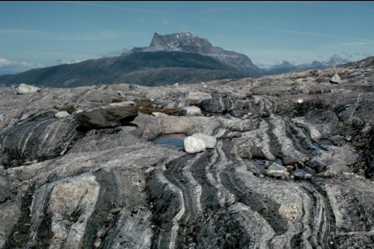
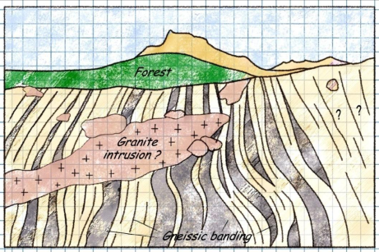
Types of Metamorphic Rocks
Metamorphic rocks are grouped into two main categories:
  Foliated Metamorphic Rocks
  Non-Foliated Metamorphic Rocks
Foliation:

Slide 26
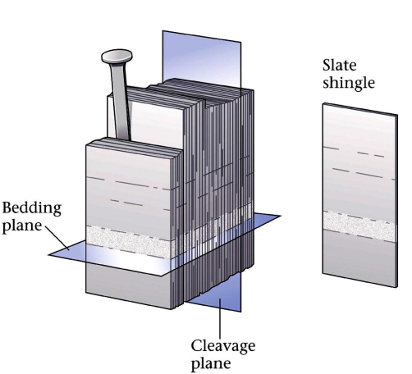
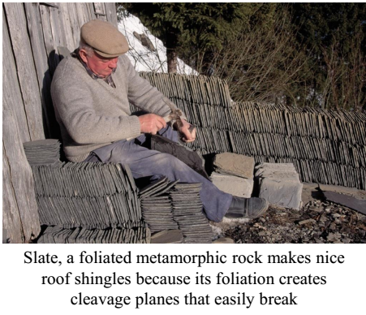
Foliated Metamorphic Rocks
These have a planar foliation caused by the preferred orientation (alignment) of minerals and formed under differential stress. They have a significant amount of sheet silicate (platy minerals and are classified by composition, grain size, and foliation type.
Happens because when rocks are subjected to differential stress, platy minerals align or alternating light and dark layers form, giving the rock a planar fabric, called foliation. Note that this is different than bedding.

Slide 27
Non-Foliated Metamorphic Rocks
Non-foliated rocks lack a planar fabric . Absence of foliation possible for several reasons:
Rock not subjected to differential stress.
Dominance of equant minerals (like quartz, feldspar, and garnet).
Absence of platy minerals (sheet silicates).

Slide 28
Scheme for Metamorphic Rock Identification
Texture |  | Composition | Type of Metamorphism | Comment | Rock Name
 |  | Mica | Regional (Heat and Pressure increase w/ depth) | Low-Grade metamorphism of SHALE
 |  | Mica, Quartz, Feldspar, Amphiboles, Garnet |  | Foliation surfaces shiny from microscopic mica crystals
 |  | Mica, Quartz, Feldspar, Amphiboles, Garnet, Pyroxene |  | Platy mica crystals visible
 |  | Mica, Quartz, Feldspar, Amphiboles, Garnet, Pyroxene |  | Compact, may split easily
Slate
MINERAL
ALIGNMENT
Phyllite
FOLIATED
Schist
BAND-
ING
Gneiss

Slide 29
Texture | Composition | Type of Metamorphism | Comment | Rock Name
 | Variable | Contact (Heat) | Various rocks changed by nearby magma/lava
 | Quartz |  | Metamorphism of Quartz
 | Calcite and/or Dolomite |  | Metamorphism of
 | Various minerals in particles and matrix |  | Pebbles may be distorted or stretched
Hornfels
Regional
(Heat
&
Pressure)
Sandstone
Quartzite
NONFOLIATED
Limestone or
Dolostone
Marble
Metaconglomerate

Slide 30
Progression of Metamorphism
Start with a shale and then hit
it with heat and pressure!
Rock Name | Rock Type | Grade of Metamorphism
Shale | Sedimentary | -----
Slate | Metamorphic | Low
Phyllite | Metamorphic | Low/Intermediate
Schist | Metamorphic | Intermediate/High
Gneiss | Metamorphic | High
Molten Rock | Cools into Igneous Rock | -----
More
Heat
&
Pressure

Slide 31
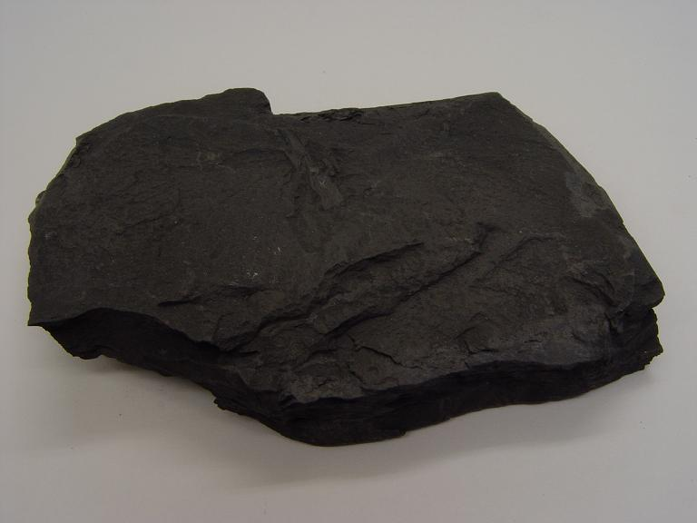
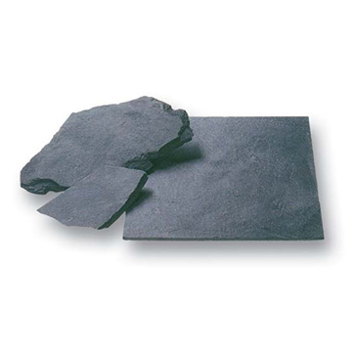
Shale
(Sedimentary Rock)
Heat
&
Pressure
Slate
(Metamorphic Rock)

Slide 32
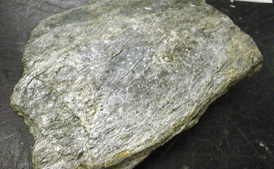
Slate
(Metamorphic Rock)
Heat
&
Pressure
Phyllite
(Metamorphic Rock)

Slide 33
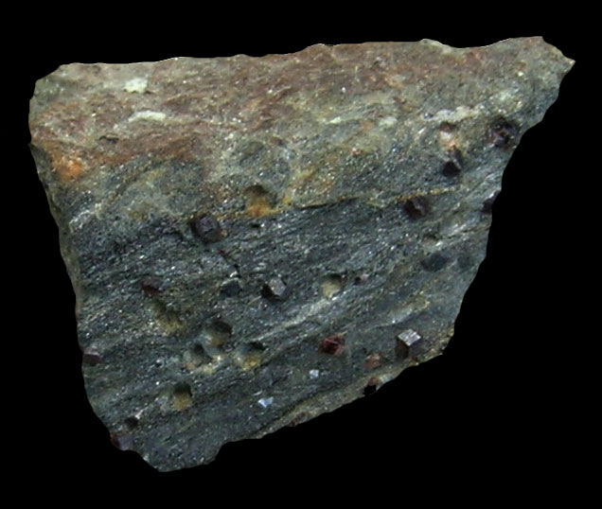
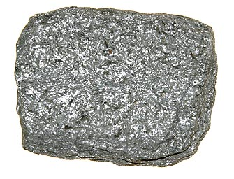
Phyllite
(Metamorphic Rock)
Heat
&
Pressure
Schist
(Metamorphic Rock)

Slide 34
Foliated Rock Textures
Foliation is broadly defined as any planar arrangement of mineral grains or structural features in a rock. Foliation can occur in both igneous and metamorphic rocks (this section will only focus on foliation in metamorphic rocks).
Foliation in metamorphic rocks occurs when the minerals in the rock align and recrystallize along planes of parallel orientation as a result of heat and compressional forces.
Minerals recrystallize into platy, elongated, or flattened grains, according to their original crystal habits. They segregate into thin layers that appear as thinly banded slivers of minerals interlayered together.
Different textures used to describe foliation include: slaty cleavage, schistosity, and gneissic texture.

Slide 35
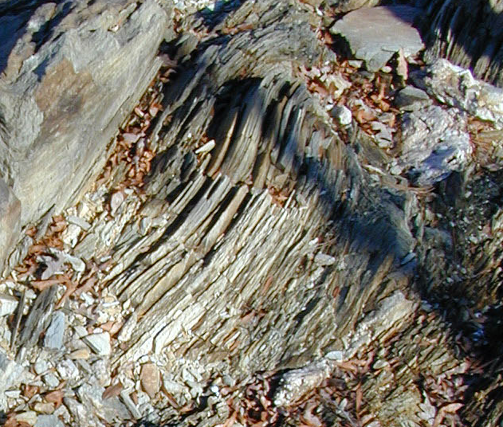
Foliated Textures: Slaty Cleavage
Slaty cleavage is used to describe rocks that split into thin, planar slabs when hit with a hammer.
Rocks with slaty cleavage often contain alternating bands of different minerals where one type of mineral (usually mica formed from recrystallized clay) forms highly aligned platy grains of foliated minerals. The rock will split into thin sections along these bands.
Slaty cleavage commonly occurs under low-grade metamorphic conditions.
The weathered exterior of this rock and broken fragments show an example of slaty cleavage from the Carolina Slate belt in South Carolina’s Piedmont.

Slide 36
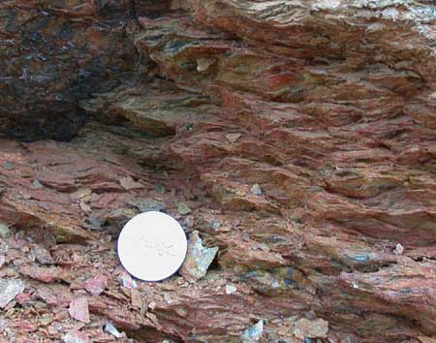
Foliated Textures: Schistosity
Schistosity describes rocks with foliated mineral grains that are large enough to see without magnification.
Schistocity occurs under medium-grade metamorphic conditions, and the crystals have a greater opportunity to grow during recrystallization.
Unlike slaty cleavage, which tends to preferentially affect some minerals more than others, schistosity tends to affect all the different mineral components.
Rocks with schistosity are generally referred to as schist.
The foliated mineral grains of this schist provide a good example of schistosity. Notice how the rock weathers in flaky sections. Rocks with schistosity can easily crumble or broken into smaller pieces with bare hands.

Slide 37
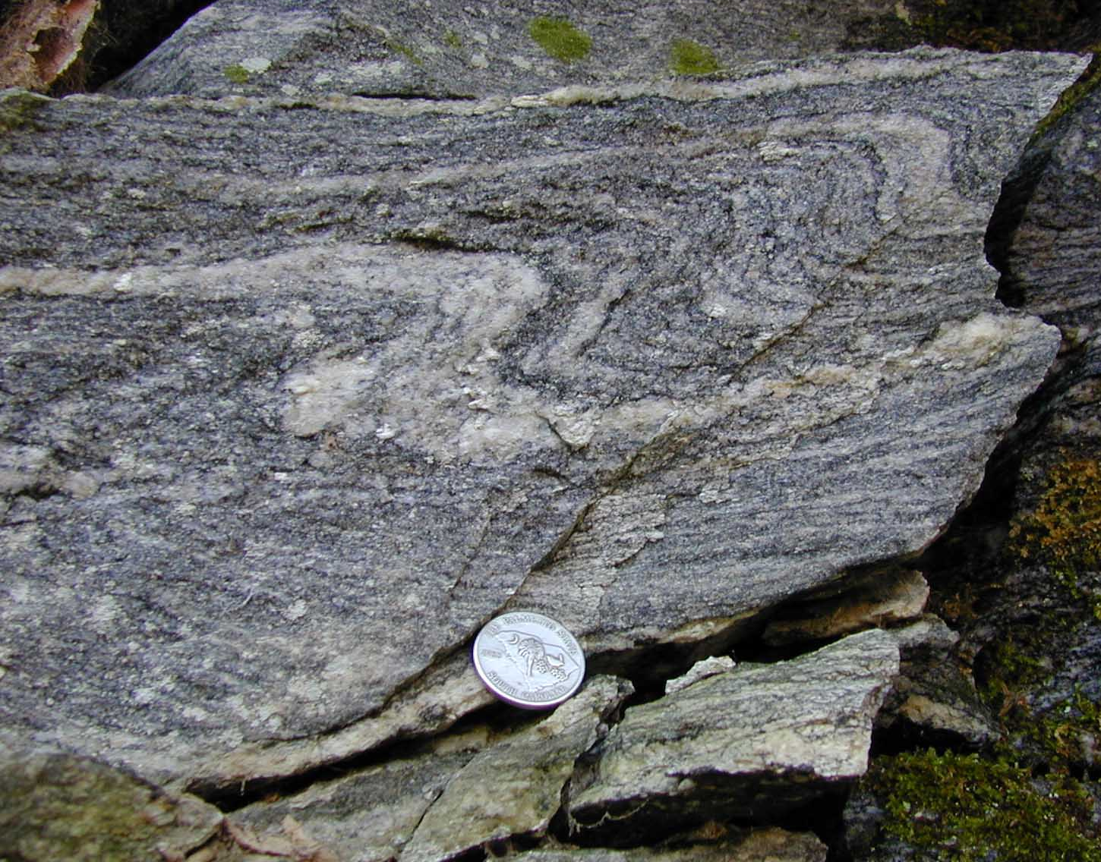
Foliated Textures: Gneissic
Gneissic textures occur when the silicate minerals in the rock separate and recrystallize into alternating bands of light (quartz and feldspar) and dark (biotite, amphibole, or hornblende) grains of silicate minerals.
The mineral alignment in gneissic rocks is less platy and more granular or elongated than slaty cleavage or schistosity.
The alternating quartz and biotite bands in this rock characterize gneissic texture. This photo also illustrates an example of folding that results from the intense heat and pressure of metamorphic conditions.

Slide 38
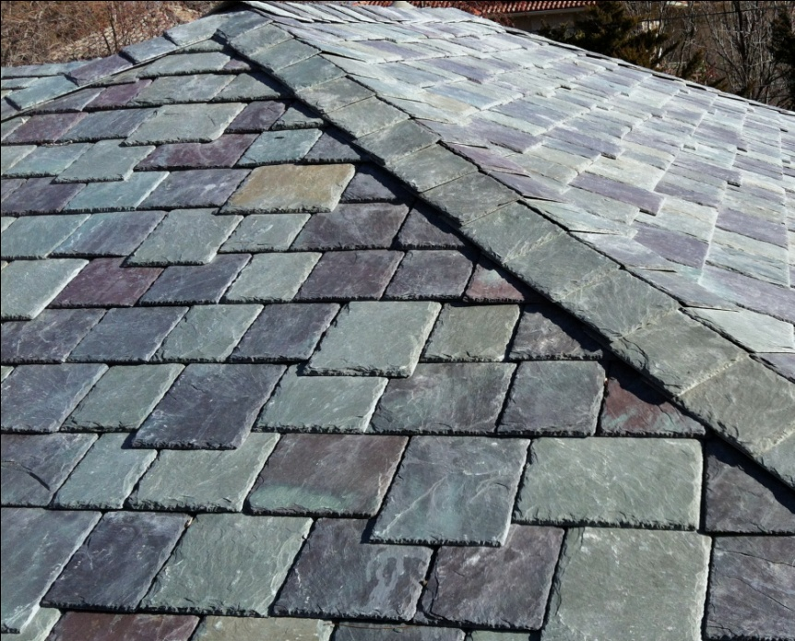
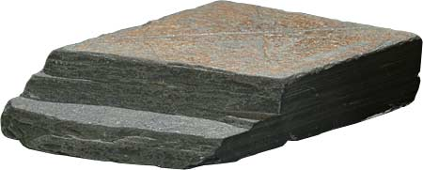
Foliated Metamorphic Rocks
SLATE
Slate is a fine-grained rock composed of mica flakes and quartz grains that enable the rock to break into thin slabs of rock, along planes of slaty cleavage.
Slate forms in low-grade metamorphic environments from a parent rock of either shale, mudstone, or siltstone.
Slate is commonly thought of as black, but it can also be red when it contains iron oxide minerals, or green when it contains chlorite. Weathered slate may even appear light brown in the example below.

Slide 39
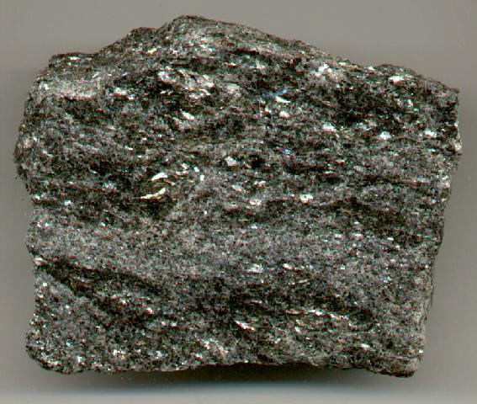
Foliated Metamorphic Rocks
SCHIST
Schist exhibits schistosity, which is formed by the alignment of platy medium- to coarse-grained minerals formed under moderate- to high-grade metamorphic conditions.
Schists are primarily composed of silicate minerals such as mica (muscovite and biotite), quartz, and feldspar .
Shale, siltstone, and some sandstones can provide the parent rock for schist.
Schist may contain accessory minerals such as garnet, tourmaline, and pyrite.

Slide 40
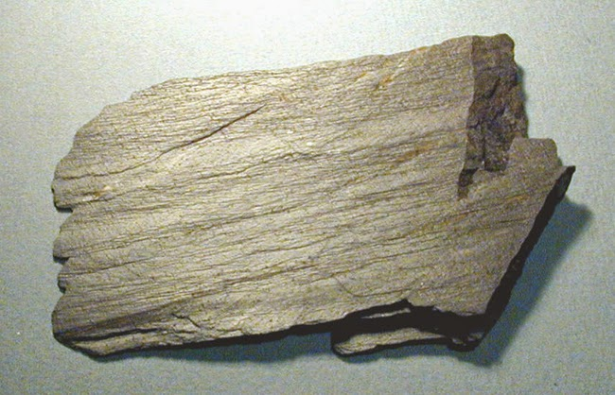
Foliated Metamorphic Rocks
PHYLLITE
Phyllite is a low- to moderate-grade metamorphic rock that contains aligned platy mica minerals and has slaty cleavage.
The individual crystals are fine grained and generally consist of muscovite, white mica, and chlorite (green rocks).
Phyllite has a satiny appearance and waxy texture.
Phyllite is a metamorphic form of shale, mudstone, and siltstone.

Slide 41
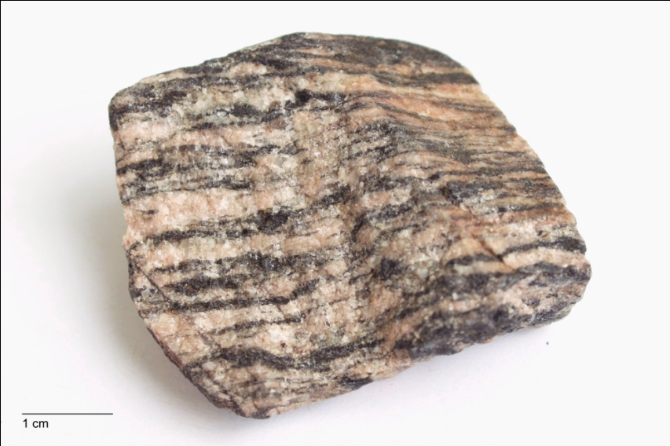
Foliated Metamorphic Rocks
GNEISS
Gneiss is a medium- to coarse-grained rock formed under high grade-metamorphic conditions.
Gneiss is primarily composed of quartz, potassium feldspar, and plagioclase feldspar with lesser amounts of biotite, muscovite, and amphibole.
Granites and sometimes rhyolite provide the parent rock for gneiss.

Slide 42
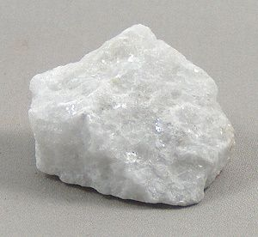
Non Foliated Metamorphic Rocks
MARBLE
Marble is a nonfoliated, coarse-grained metamorphic rock formed from the parent rock limestone or dolostone.
Because it is formed from limestone or dolostone it is predominantly composed of the mineral calcite, which metamorphoses into various carbonate and other minerals. As calcite recrystallizes, all the grains are active at the same time and they grow to the same size and shape, which leads to its nonfoliated texture.
Different color schemes in marble are the result of impurities or the presence of weathered materials deposited in or near the limestone.

Slide 43
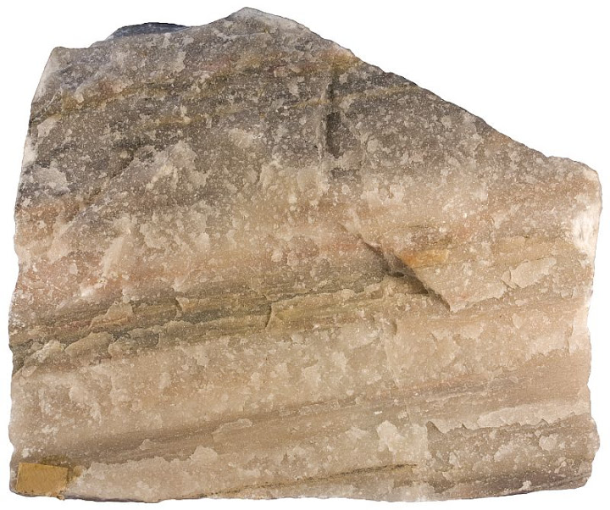
Non Foliated Metamorphic Rocks
QUARTZITE
Quartzite is a metamorphic rock formed under moderate to high-grade metamorphism that exhibits both foliated and nonfoliated structure.
The parent rock to quartzite is sandstone.
Quartzite forms from the recrystallization of quartz grains in the sandstone and often the resulting metamorphic rock will preserve vestiges of the original bedding patterns .
Quartz is predominantly white in color, but can also contain pinkish or grayish shades depending on the presence of iron oxides.

Slide 44
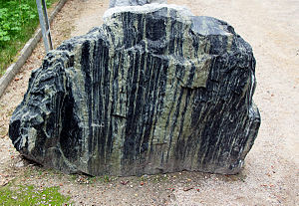
Non Foliated Metamorphic Rocks
AMPHIBOLITE
These rocks are dark colored rocks with amphibole (usually hornblende) as their major mineral.
They are usually poorly foliated and form at intermediate to high grades of
metamorphism of basaltic or gabbroic protoliths.

Slide 45

Non Foliated Metamorphic Rocks
HORNFELS
Rock that undergoes heating in the absence of significant differential stress.
Typically hornfels form when rocks are baked by igneous intrusions (contact metamorphism).
No foliation is present because crystals grow in random orientations due to a lack of significant differential stress.
Composition varies and depends on composition of protolith.

Slide 46


Slide 47


