Slide 1
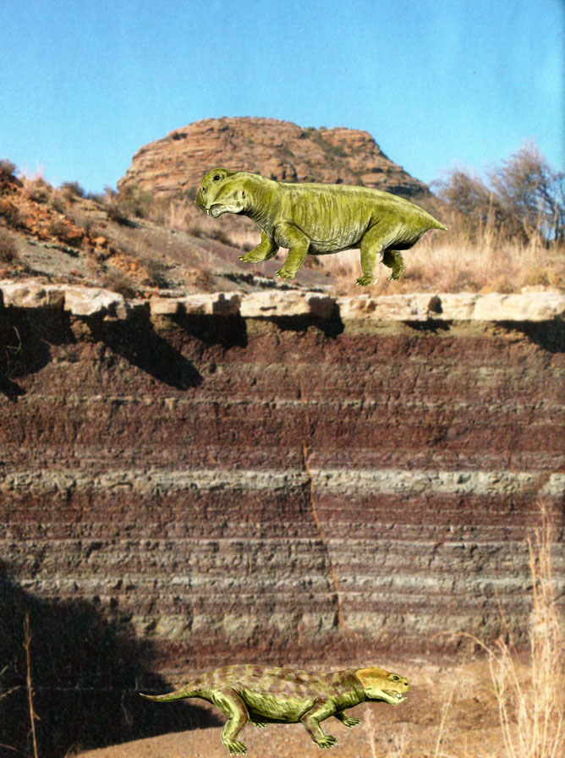


SEDIMENTARY
ROCK

Slide 2
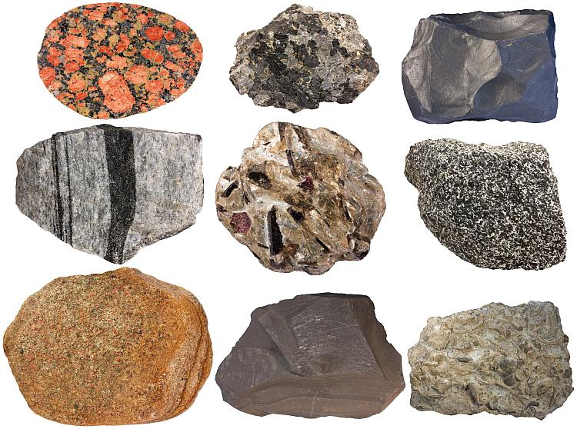
Sedimentary Rock
Sedimentary comes from the latin word “Sedimentum” means settling
Sedimentary rocks result from mechanical and chemical weathering
Comprise ~ 5% of Earth’s upper crust
About 75% of rocks at surface
Contain evidence of past environments
    Record how sediment is transported
    Often contain fossils

Slide 3
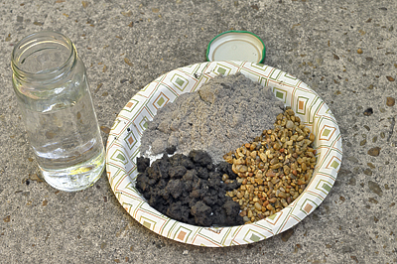
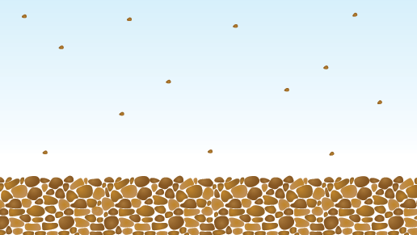
Sediment
loose, solid particles originating from:
Weathering and erosion of preexisting rocks
Chemical precipitation from solution, including secretion by organisms in water
Classified by particle size
Boulder - >256 mm
Cobble - 64 to 256 mm
Pebble - 2 to 64 mm
Sand - 1/16 to 2 mm
Silt - 1/256 to 1/16 mm
Clay - <1/256 mm

Slide 4
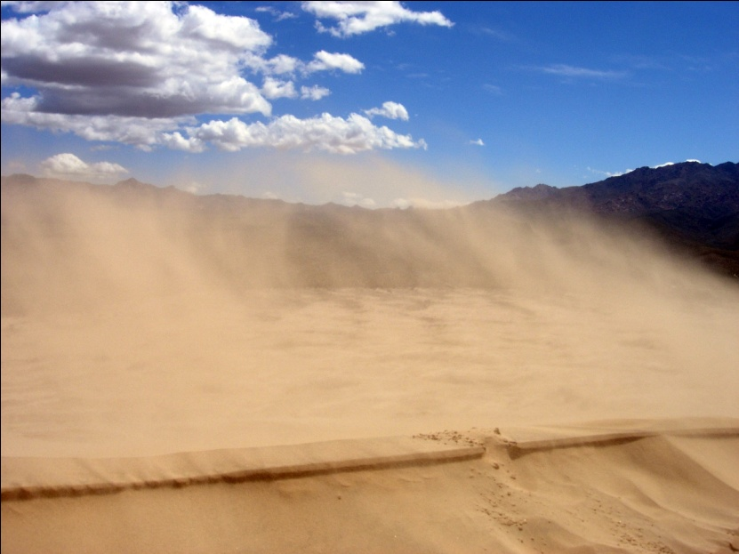
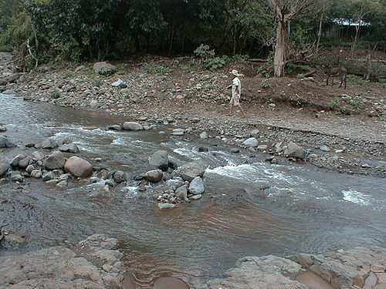
Relationship to Earth’s Systems
• Atmosphere
– Most sediments produced by weathering in air
– Sand and dust transported by wind
• Hydrosphere
– Water is a primary agent in sediment production, transportation, deposition, cementation, and formation of sedimentary rocks
• Biosphere
– Oil, the product of partial decay of organic materials, is found in sedimentary rocks

Slide 5
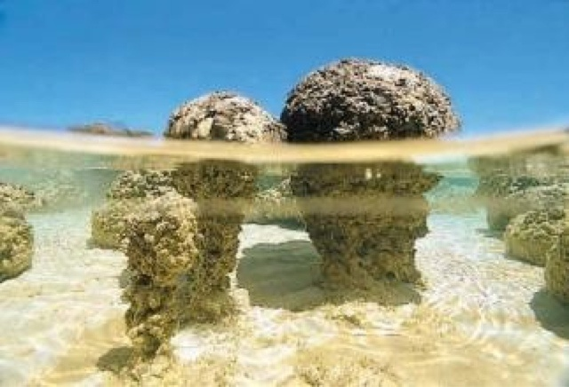
Sedimentary Environments
If we look at various environments now present on Earth, we can find characteristics in the sediment that
are unique to each environment. If we find those same characteristics in sedimentary rocks, it allows us
to interpret the environment of the past. Each environment has its own energy regime and sediment
delivery, transport and depositional conditions that are reflected in the sediment deposited.
Sedimentary Environments can be divided into the following:
Terrestrial (Non-marine) environments
Glacial
Alluvial fans
Sand Dunes
Mountain Streams
Lakes
Rivers
Marine environments
Deltas
Coastal Beaches
Shallow Marine Clastics
Shallow Marine Carbonates
Deep Marine

Slide 6
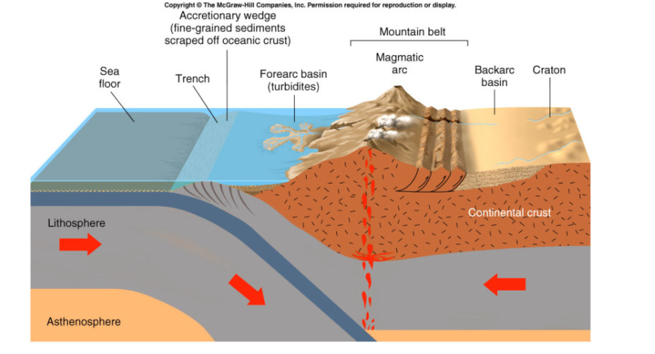
Plate Tectonics and Sedimentary Rocks
• Tectonic setting plays key role in the distribution of sedimentary rocks
• Occurrence of specific sedimentary rock types can be used to reconstruct past plate-tectonic settings
• Erosion rates and depositional characteristics give clues to each type of tectonic plate boundary
• Convergent boundary: Rapid erosion: coarse-grained clastic sediments are transported by streams and turbidity currents and are deposited in basins near mountains.

Slide 7
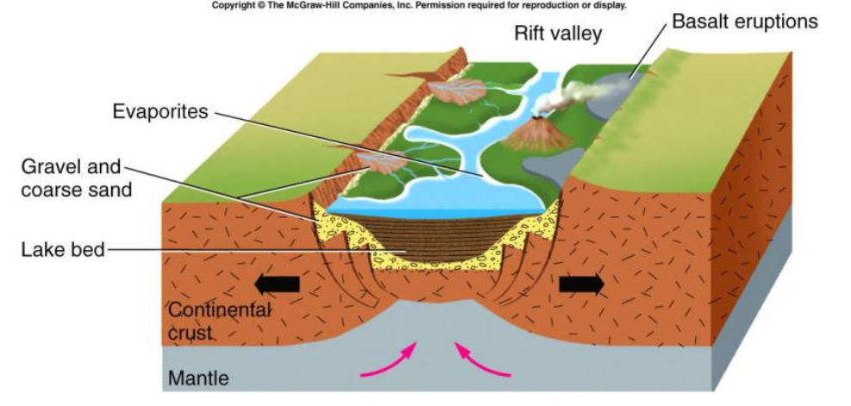
• Divergent boundary: thick wedges of gravel and coarse sand along fault-bounded margins of developing rift valley. Lake bed deposits and evaporate rocks are located on the floor of the rift valley.

Slide 8
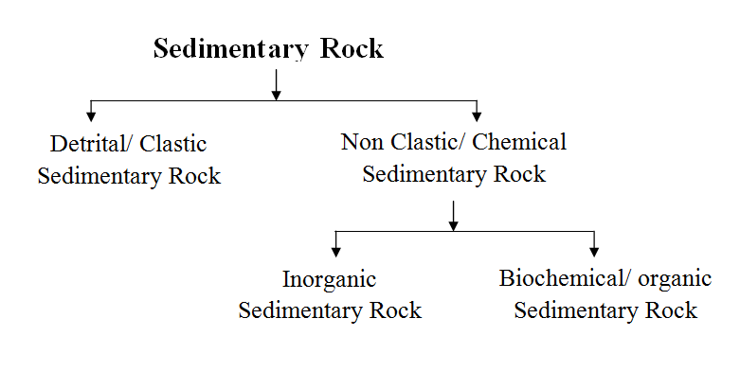
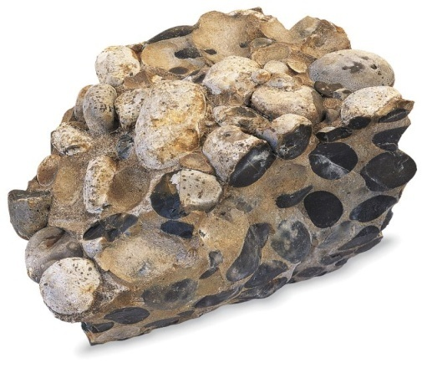
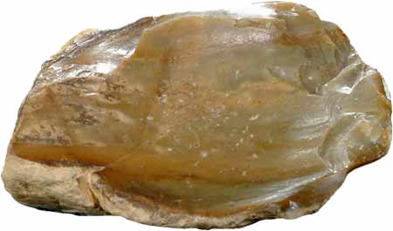
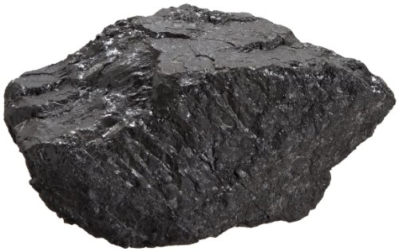
Types of Sedimentary Rocks

Slide 9
Rivers, oceans, winds, and rain runoff all have the ability to carry the particles washed off of eroding rocks. Such material, called detritus, consists of fragments of rocks and minerals.
When the energy of the transporting current is not strong enough to carry these particles, the particles drop out in the process of sedimentation. This type of sedimentary deposition is referred to as clastic sedimentation.
Another type of sedimentary deposition occurs when material is dissolved in water, and chemically precipitates from the water. This type of sedimentation is referred to as chemical sedimentation.
A third process can occur, wherein living organisms extract ions dissolved in water to make such things as shells and bones. This type of sedimentation is called biochemical sedimentation. The accumulation of plant matter, such as at the bottom of a swamp, is referred to as organic sedimentation.
Thus, there are 4 major types of sedimentary rocks: Clastic Sedimentary Rocks, Chemical Sedimentary Rocks, Biochemical Sedimentary Rocks, and Organic Sedimentary Rocks.

Slide 10
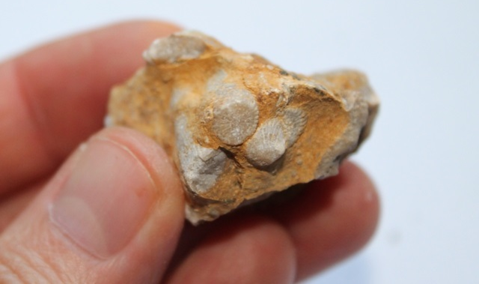
Clastic Sedimentary Rocks
Consist of solid particles from weathered rocks. These rock fragments include pebbles, sand, silt and clay.
Rock fragments are a result of physical weathering
These rocks usually form in water environments such as, rivers, lakes, oceans, but can also form in deserts.
Geologist use particle size to distinguish between clastic sedimentary rocks, as seen in the table below.
Particle Name | Sediment Name | Rock Name
Boulder Pebble | Gravel (Round or Angular) | Conglomerate or Breccia
Sand | Sand | Sandstone
Silt / Clay | Mud | Siltstone/Shale

Slide 11
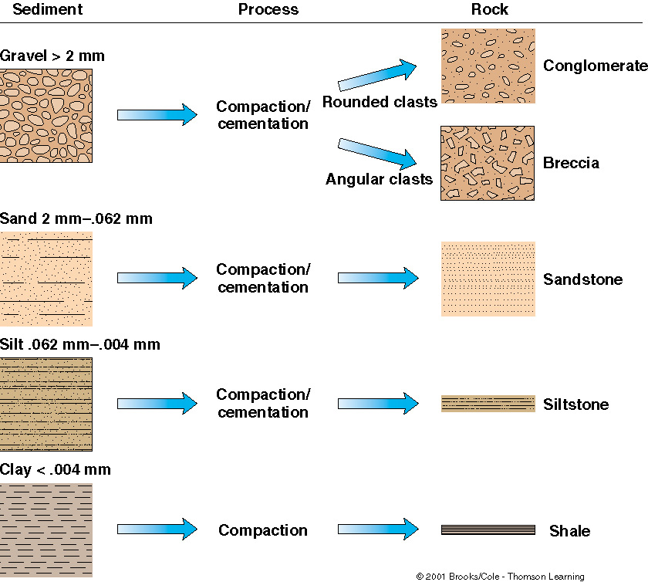
This figure shows how clastic sediment of various sizes will, after compaction and cementation,
form different types of detrital sedimentary rocks.

Slide 12
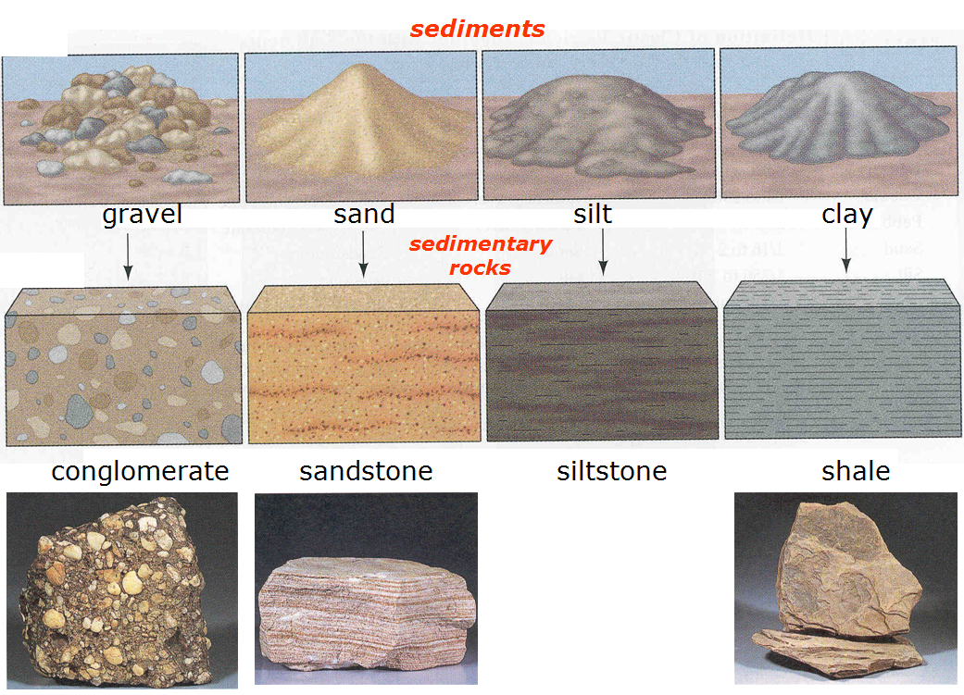

Slide 13
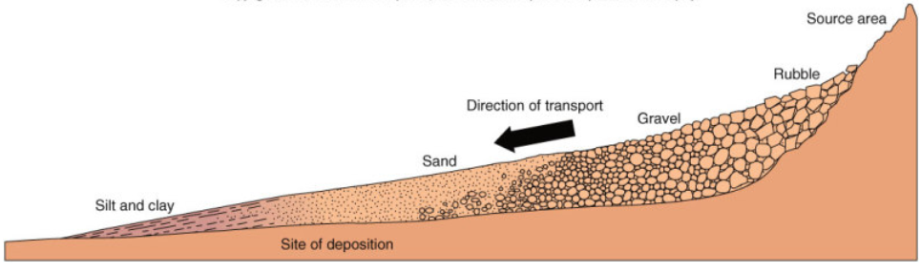
Formation of Clastic Sediments and Sedimentary Rocks
The formation of a clastic sediment and sedimentary rocks involves five processes:
1. Weathering
2. Erosion
3. Transportation
4. Deposition
5. Lithification (Diagenesis)

Slide 14
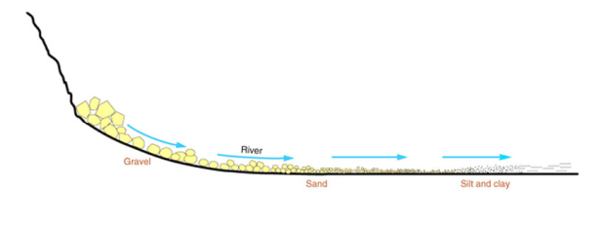
Weathering - The first step is transforming solid rock into smaller fragments or dissolved ions by physical and chemical weathering.
2. Erosion - Erosion is actually many process which act together to lower the surface of the earth. In terms of producing sediment, erosion begins the transpiration process by moving the weathered products from their original location. This can take place by gravity (mass wasting events like landslides or rock falls), by running water. by wind, or by moving ice. Erosion overlaps with transpiration.
3. Transportation - Sediment can be transported by sliding down slopes, being picked up
by the wind, or by being carried by running water in streams, rivers, or ocean currents.
The distance the sediment is transported and the energy of the transporting medium all
leave clues in the final sediment that tell us something about the mode of transportation.

Slide 15
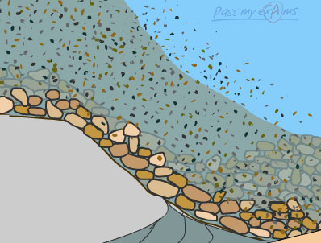
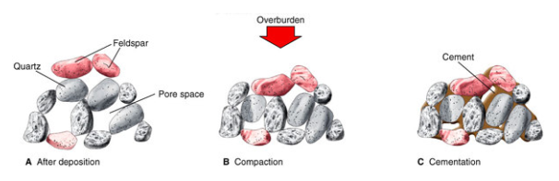
4. Deposition - Sediment is deposited when the energy of the transporting medium becomes too low to continue the transport process. In other words, if the velocity of the transporting medium becomes too low to transport sediment, the sediment will fall out and become deposited. The final sediment thus reflects the energy of the transporting medium.
5. Lithification (Diagenesis) - Lithification is the process that turns sediment into rock. The first stage of the process is compaction. Compaction occurs as the weight of the overlying material increases. Compaction forces the grains closer together, reducing pore space and eliminating some of the contained water. Some of this water may carry mineral components in solution, and these constituents may later precipitate as new minerals in the pore spaces. This causes cementation, which will then start to bind the individual

Slide 16
Sediment Maturity
Sediment Maturity refers to the length of time that the sediment has been in the sedimentary
cycle. Texturally mature sediment is sediment that is well rounded, (as rounding increases
with transport distance and time) and well sorted (as sorting gets better as larger clasts are left
behind and smaller clasts are carried away. Because the weathering processes continues during
sediment transport, mineral grains that are unstable near the surface become less common as
the distance of transport or time in the cycle increases. Thus compositionally mature sediment
is composed of only the most stable minerals.
For example a poorly sediment containing glassy angular volcanic fragments, olivine crystals
and plagioclase is texturally immature because the fragments are angular, indicating they have
not been transported very far and the sediment is poorly sorted, indicating that little time has
been involved in separating larger fragments from smaller fragments. It is compositionally
immature because it contains unstable glass along with minerals that are not very stable near
the surface - olivine and plagioclase.
On the other hand a well sorted beach sand consisting mainly of well rounded quartz grains is
texturally mature because the grains are rounded, indicating a long time in the transportation
cycle, and the sediment is well sorted, also indicative of the long time required to separate the
coarser grained material and finer grained material from the sand. The beach sand is
compositionally mature because it is made up only of quartz which is very stable at the earth's surface.

Slide 17
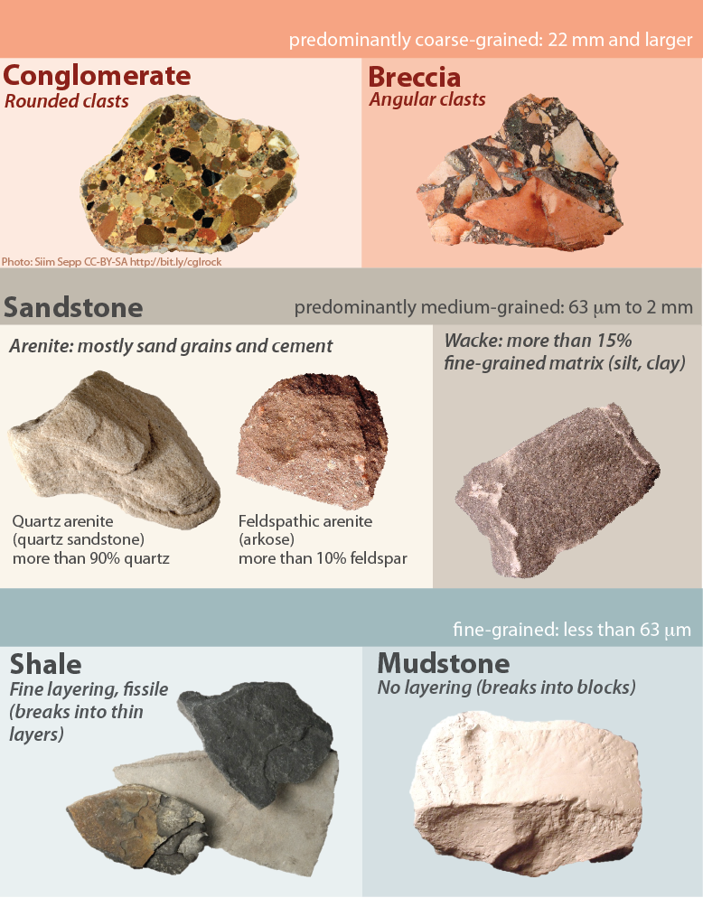
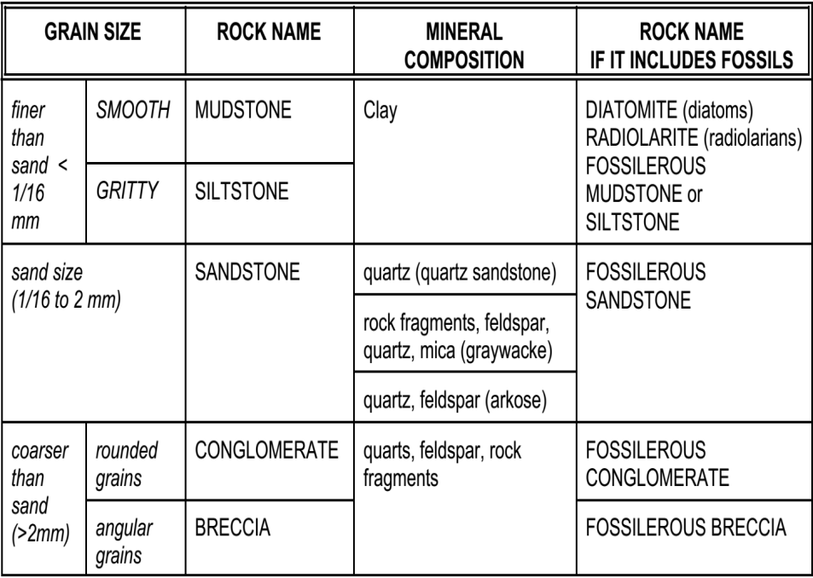
Different Clastic
Sedimentary Rocks

Slide 18
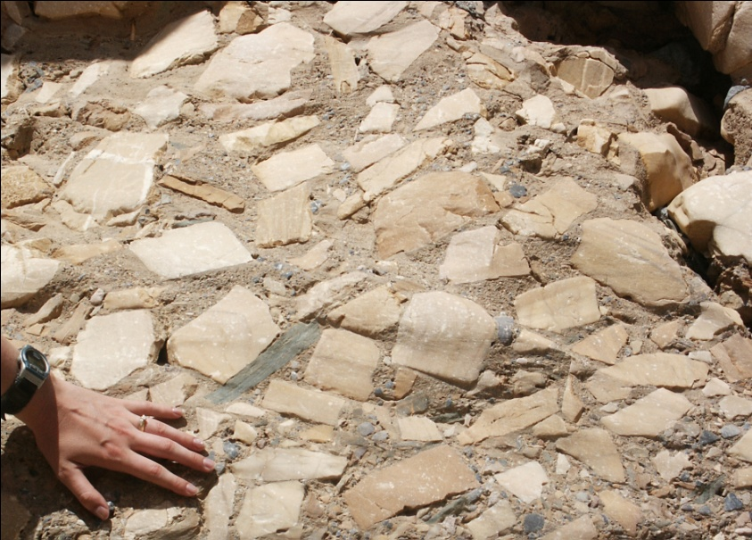
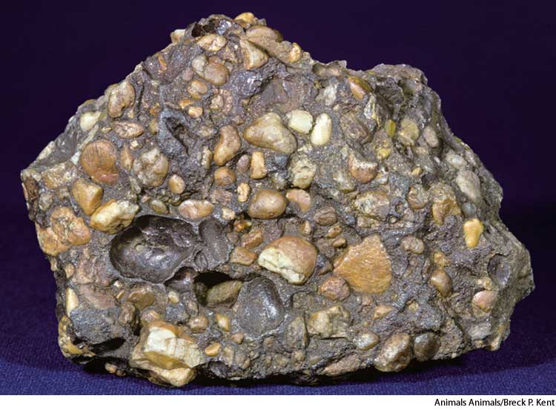
Conglomerates and Breccias
Conglomerate and Breccia are rocks that contain an abundance of coarse grained clasts (pebbles, cobbles, or boulders).
In a conglomerate, the coarse grained clasts are well rounded, indicating that they spent considerable time in the transportation process and were ultimately deposited in a high energy environment capable of carrying the large clasts.
In a breccia, the coarse grained clasts are very angular, indicating the the clasts spent little time in the transportation cycle.
conglomerate
breccia

Slide 19
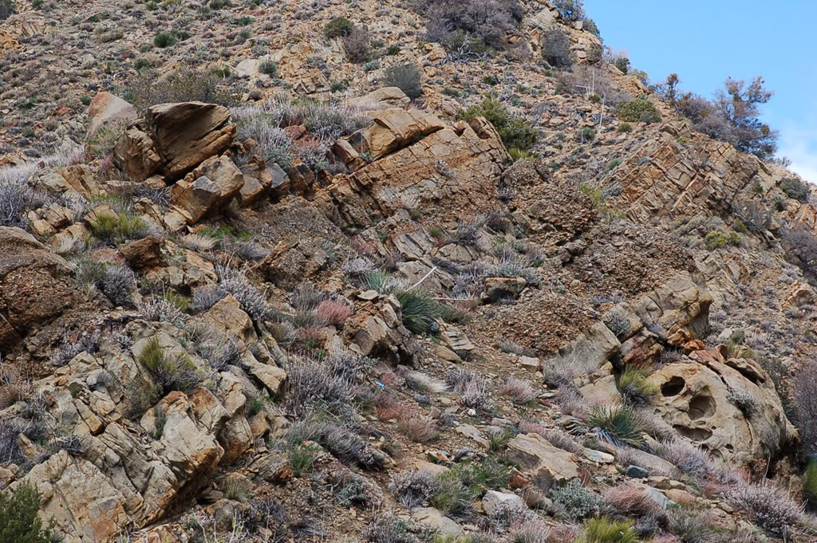

Slide 20
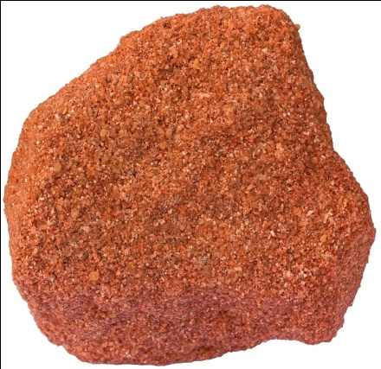
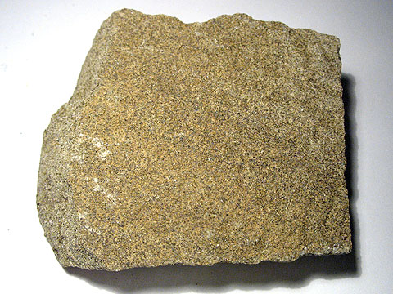
Sandstones
A Sandstone is made of sand-sized particles and forms in many different depositional
settings. Texture and composition permit historic interpretation of the transport and
depositional cycle and sometimes allows determination of the source. Quartz is, by far,
the dominant mineral in sandstones. Still there are other varieties. A Quartz arenite – is
nearly 100% quartz grains. An Arkose contains abundant feldspar. In a lithic sandstone,
the grains are mostly small rock fragments. A Wacke is a sandstone that contains more
than 15% mud (silt and clay sized grains). Sandstones are one of the most common
types of sedimentary rocks.

Slide 21
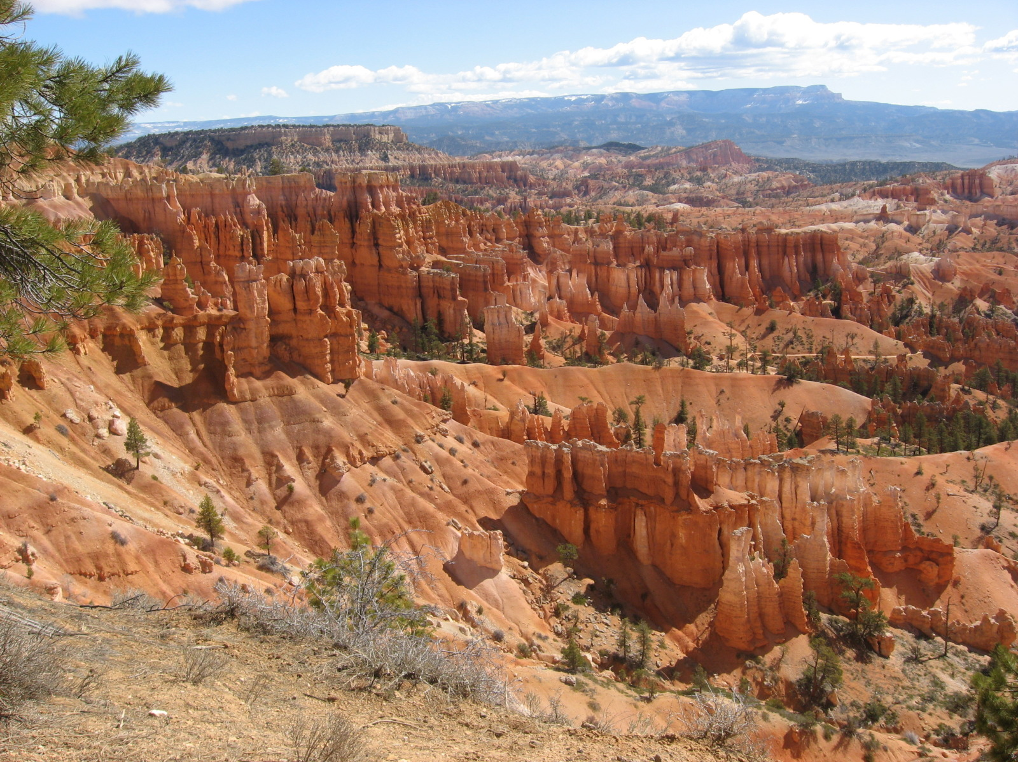
Sandstone

Slide 22
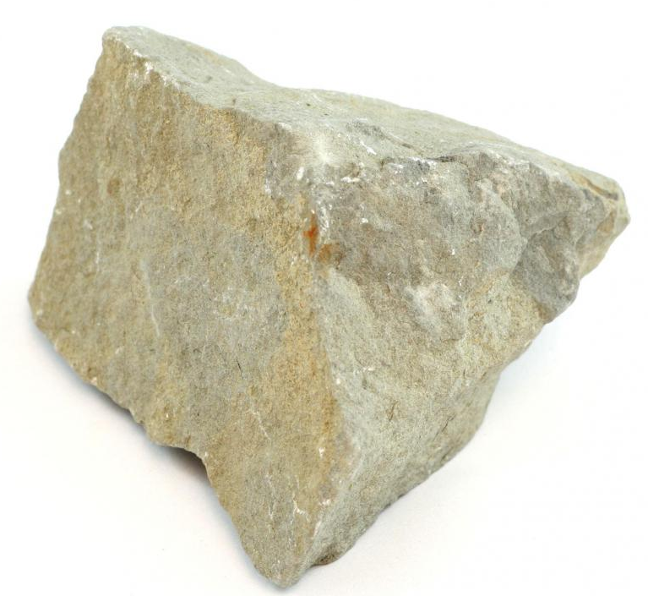
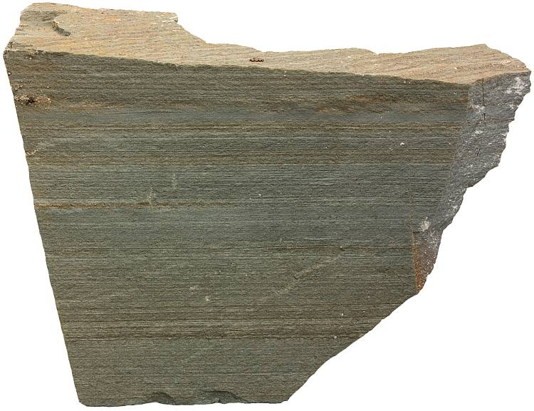
Mudrocks/ Mudstone
Mudrocks are made of fine grained clasts (silt and clay sized) .
A siltstone is one variety that consists of silt-sized fragments.
A shale is composed of clay sized particles and is a rock that tends to break into thin flat fragments (See figure 7.6e in your text).
A mudstone is similar to a shale, but does not break into thin flat fragments. Organic-rich shales are the source of petroleum.
Fine grained clastics are deposited in non-agitated water, calm water, where there is little energy to continue to transport the small grains. Thus mudrocks form in deep water ocean basins and lakes.
siltstone
shale

Slide 23
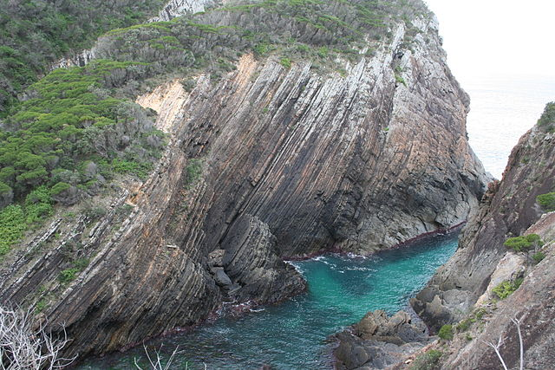
siltstone

Slide 24
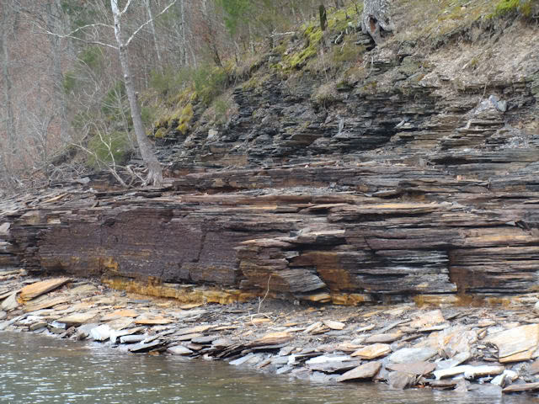
shale

Slide 25
Chemical Sedimentary Rocks
These rocks form as a result of chemical weathering dissolving chemicals and transporting it in solution. When conditions are right, these dissolved chemicals change back into a solid through the processes of precipitation and evaporation.
Precipitation: Process where chemicals dissolved on solution, fall out of solution and forms a solid material. Most common in shallow water environments.
Evaporation: Process where there is a change in state from a liquid to a gas. Chemicals dissolved in the liquid (water) are left behind as a solid material.
Precipitation may occur as a result of physical processes, or indirectly through life processes of water-dwelling organisms. Sedimentary rock formed in this way is referred to as Biochemical.
Many organisms excrete dissolved minerals to form shells and when they die the shells accumulate on the sea floor and form a rock called Coquina.
Note: Evaporation and Precipitation often work together. As water evaporates, chemicals in solution will precipitate. Example: Rock Salt (Halite)
These rocks usually form in water environments such as lakes and shallow seas or oceans.
Some examples of chemical sedimentary rocks include;
Limestone (Calcite) - (form by precipitation)
Rock Gypsum - (form by precipitation and evaporation)
Rock salt (Halite) – (from by evaporation)
Coquina - (form by biochemical processes)

Slide 26
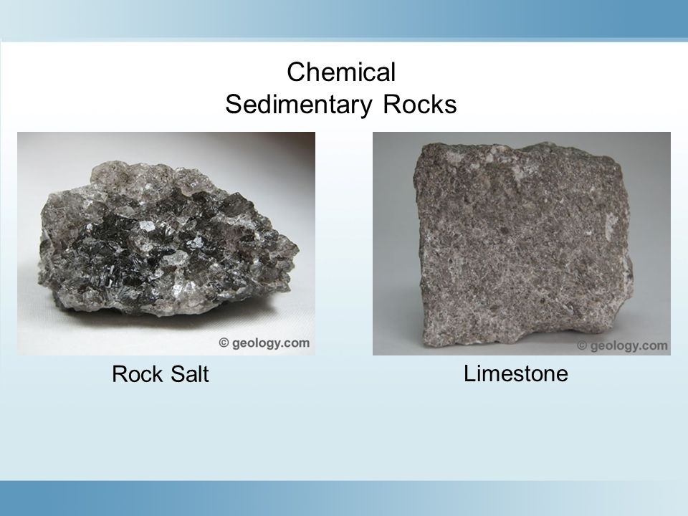
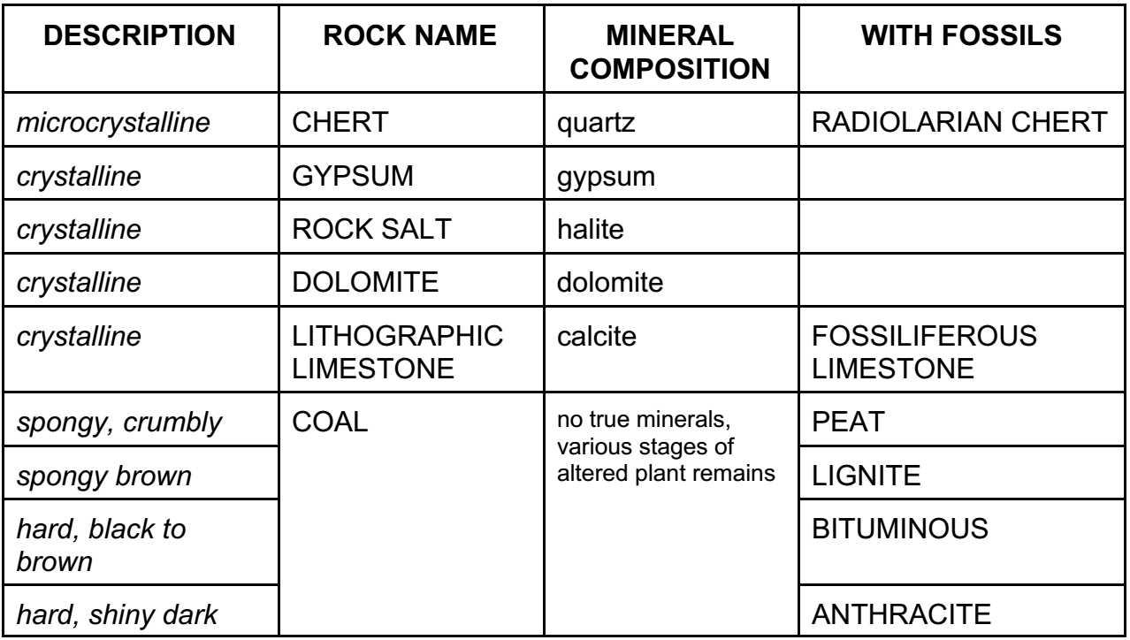
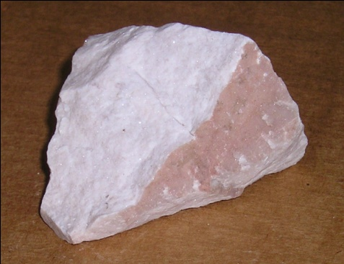
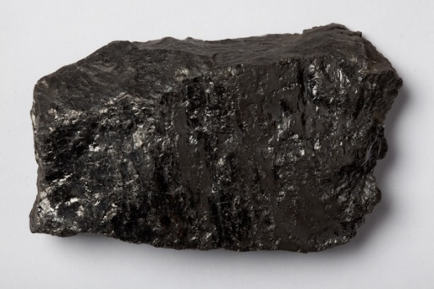
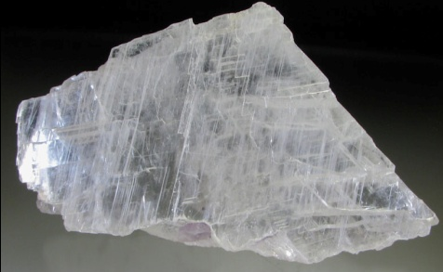
Different Chemical Sedimentary Rocks
limestone
Rock Salt
Gypsum
Chert
Coal
Dolomite

Slide 27
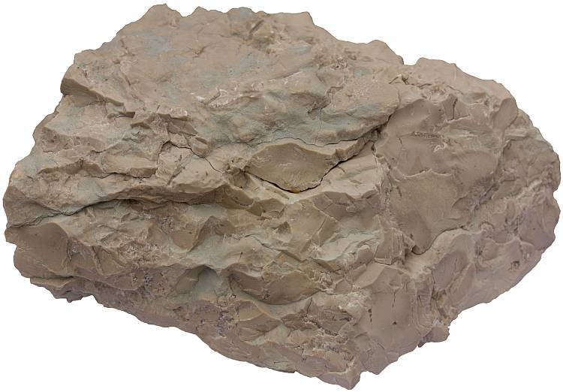
Cherts
Groundwater flowing through rock can precipitate SiO2 to replace minerals that were
present. This produces a non-biogenic chert. Can occur as layers or as lumpy nodules
within other sedimentary rocks, especially limestones There are many varsities of such
chert that are given different names depending on their attributes, For example:
Flint – Black or gray from organic matter.
Jasper – Red or yellow from Fe oxides.
Petrified wood – Wood grain preserved by silica.
Agate – Concentrically layered rings

Slide 28
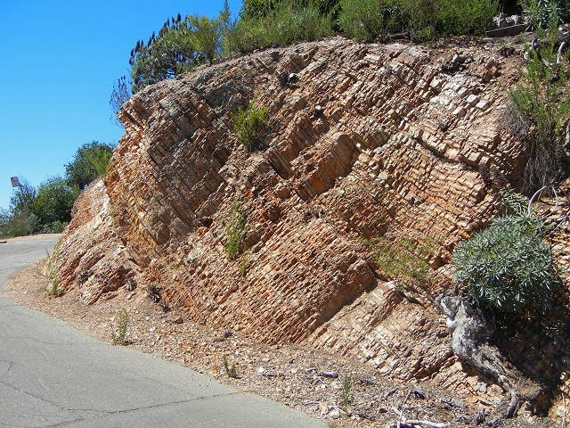

Slide 29
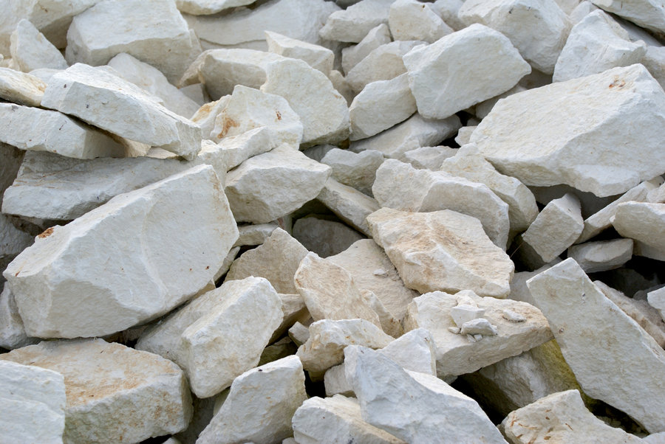
Limestone
Most abundant chemical rock
Made of the mineral calcite CaCO₃
Most are biochemical, but can be inorganic
Often contain easily recognizable fossils
Chemical alteration of limestone in Mg-rich water solutions can produce
Marine biochemical limestones form as coral reefs, coquina (broken shells), and chalk (microscopic organisms)
Inorganic limestones include travertine (caves) and oolitic limestone (Bahamas)

Slide 30
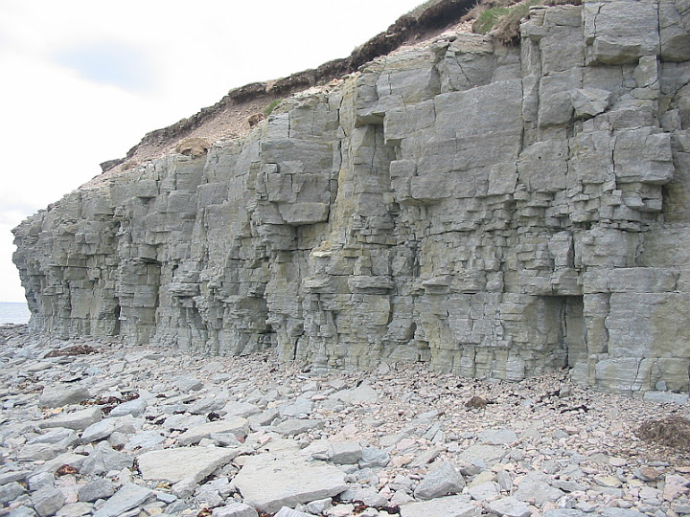

Slide 31
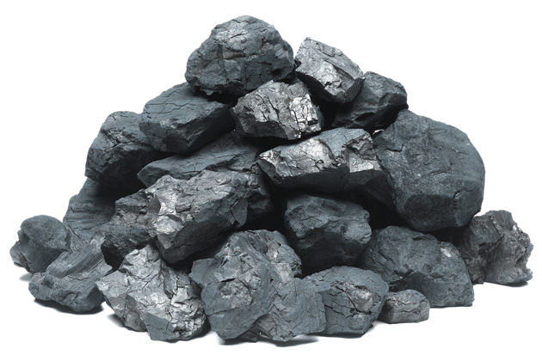
Coal
Coal is an organic rock made from organic carbon that is the remains of fossil plant
matter.
Organic material deposited in water with low oxygen content (i.e., stagnant)
It is high in carbon and can easily be burned to obtain energy.
major fuel for power plants
70% of coal usage: electricity
many problems: pollution, health, wastelands
lots more available
formation: swamps

Slide 32
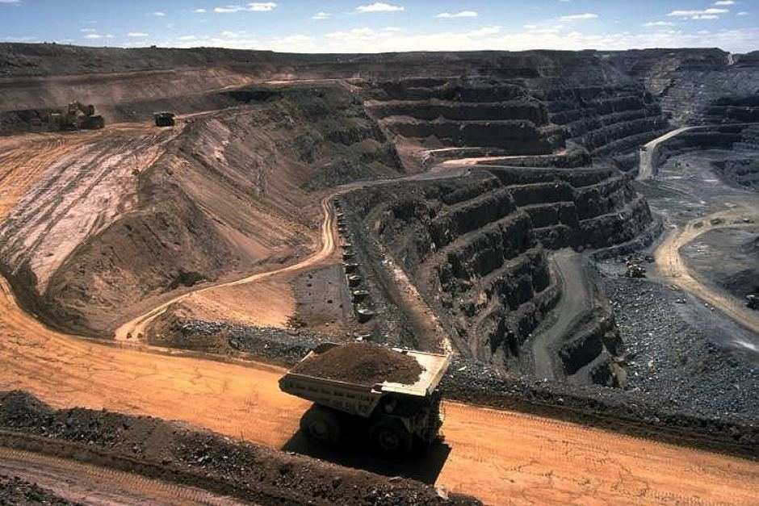

Slide 33
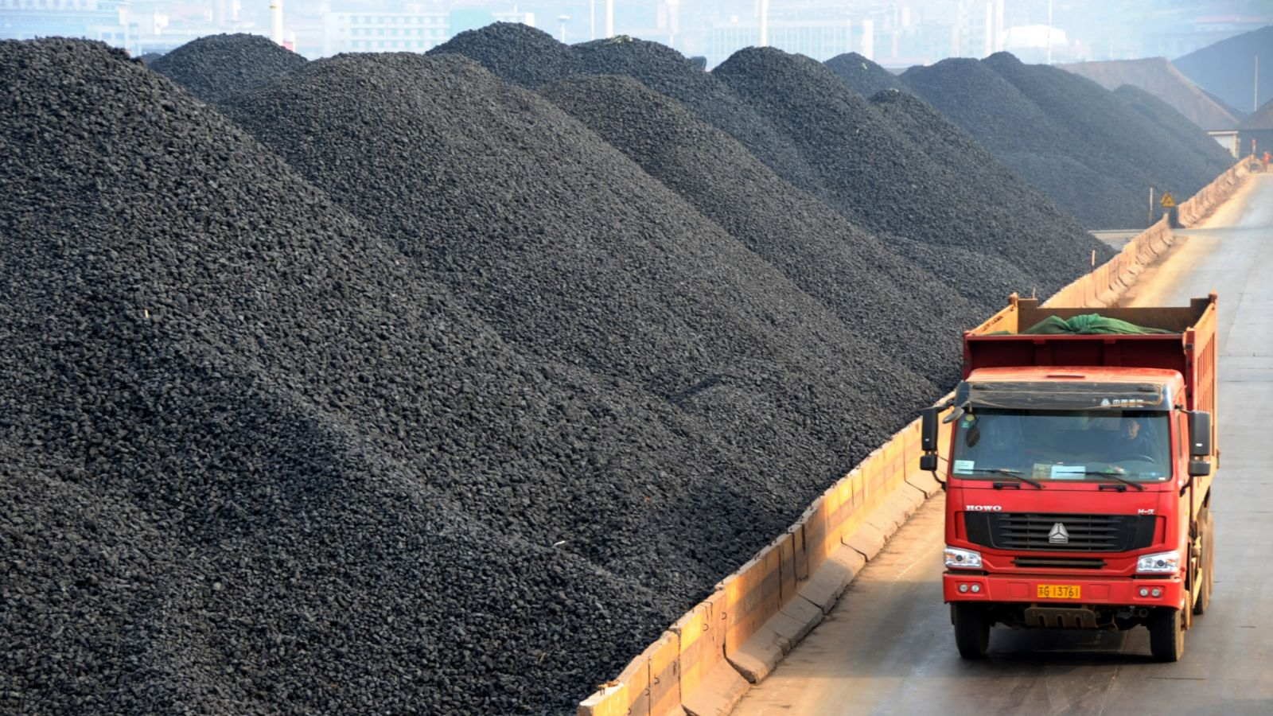

Slide 34
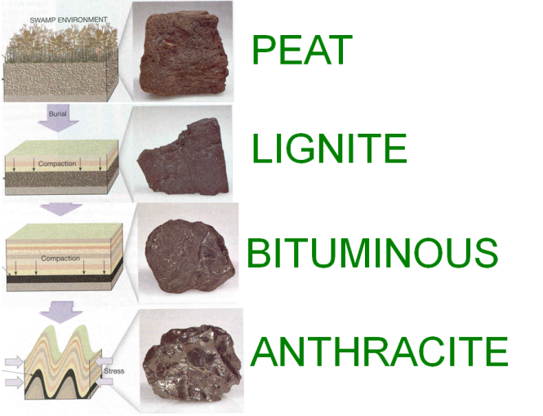
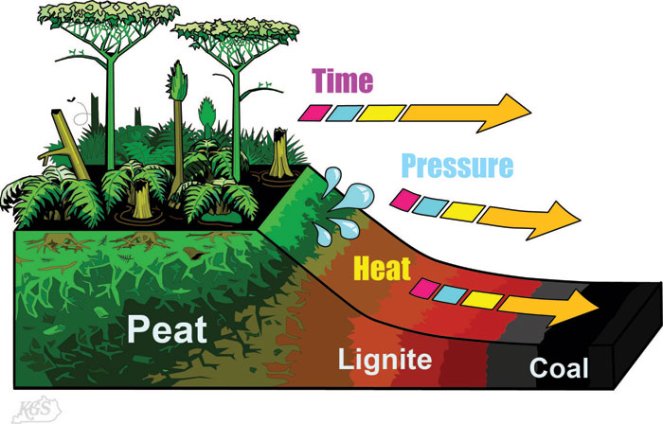
Stages of coal formation

Slide 35
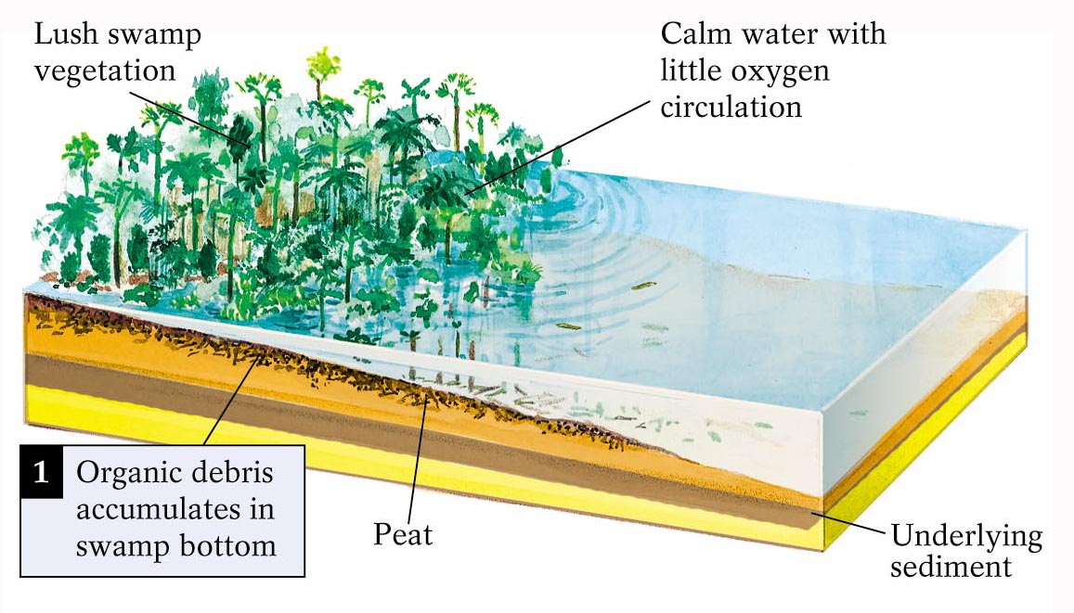
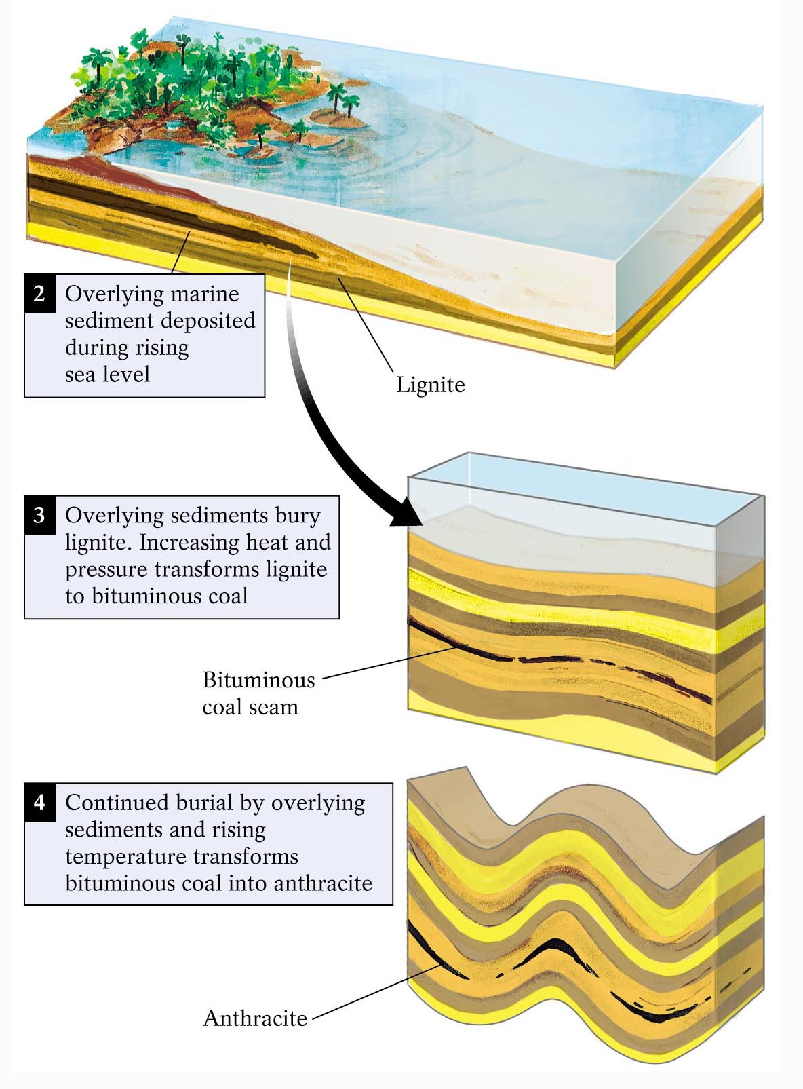
Formation of coal from swamp deposits

Slide 36
Sedimentary Structures
Features within sedimentary rocks produced during or just after sediment deposition
Provide clues to how and where deposition of sediments occurred.
All stages of the sedimentary cycle leave clues to processes that were operating in the past. Perhaps the most easily observable clues are structures left by the depositional process.
We here discuss sedimentary structures and the information that can be obtained from these structures.
Stratification and Bedding
Rhythmic Layering
Cross Bedding
Graded Bedding
Non-sorted Sediment
Ripple Marks
Mudcracks
Sole Marks
Raindrop Marks
Fossils

Slide 37
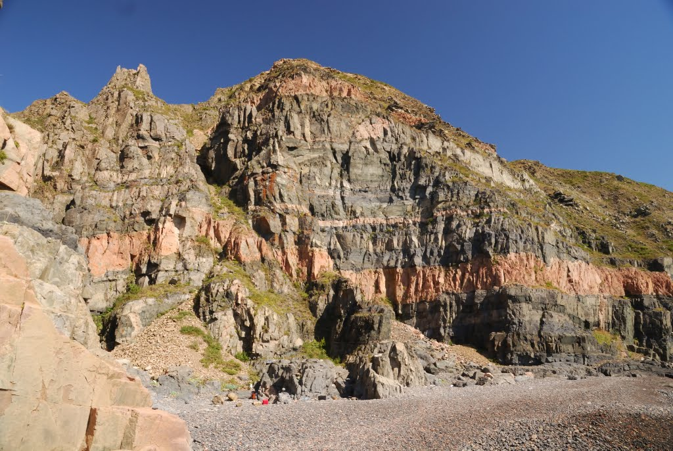
Stratification and Bedding
Most common sedimentary structure. Series of visible layers within a rock. Because sediment is deposited in low lying areas that often extend over wide areas, successive depositional events produce layers called bedding or stratification that is usually the most evident feature of sedimentary rocks. The layering can be due to differences in color of the material, differences in grain size, or differences in mineral content or chemical composition. All of these differences can be related to differences in the environment present during the depositional events.
A series of beds are referred to as strata. A sequence of strata that is sufficiently unique to be recognized on a regional scale is termed a formation. A formation is the fundamental geologic
mapping unit.

Slide 38
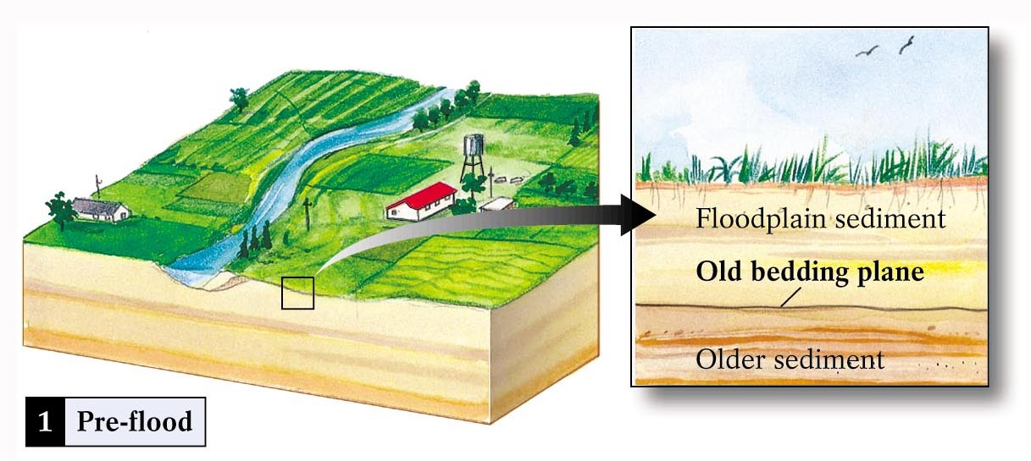


Development of a bedding plane

Slide 39


Rhythmic Layering
Alternating parallel layers having different properties. Sometimes caused by seasonal changes in deposition (Varves). i.e. lake deposits wherein coarse sediment is deposited in summer months and fine sediment is deposited in the winter when the surface of the lake is frozen.

Slide 40


Cross Bedding
Sets of beds that are inclined relative to one another. The beds are inclined in the direction that the wind or water was moving at the time of deposition. Boundaries between sets of cross beds usually represent an erosional surface. Very common in beach deposits, sand dunes, and river deposited sediment.

Slide 41



Slide 42


Graded Bedding
As current velocity decreases, first the larger or more dense particles are deposited followed by smaller particles. This results in bedding showing a decrease in grain size from the bottom of the bed to the top of the bed. Sediment added as a pulse of turbid water. As pulse wanes, water loses velocity and sediments settle. Coarsest material settles first, medium next, then fine. Multiple graded-bed sequences called turbidites.

Slide 43


Slide 44



Ripple Marks
Water flowing over loose sediment creates bedforms by moving sediment with the flow.
Bedforms are linked to flow velocity and sediment size. Ripples are characteristic of shallow water deposition and can also be caused by wind. blowing over the surface. Sand dunes are similar, but on a larger scale. Ripples are commonly preserved in sedimentary rocks.
Asymmetric ripples (as shown above) indicate flow direction, with the steep slope on the down - current direction. Ripples persevered in ancient rocks can also be indicators of up/down direction in the original sediment.
Symmetric ripples form as a result of constant wave energy oscillating back and forth.
Small ridges formed on surface of sediment layer by moving wind or water

Slide 45

Mudcracks
Polygonal cracks formed in drying mud result from the drying out of wet sediment at the surface of the Earth. The cracks form due to shrinkage of the sediment as it dries. When present in rock, they indicate that the surface was exposed at the earth's surface and then rapidly buried
Origin of mud cracks

Slide 46


Slide 47



Fossils
Traces of plants or animals preserved in rock
Hard parts (shells, bones) more easily preserved as fossils
Different species usually inhabit specific environments.
Because life has evolved - fossils give clues to relative age of the sediment.
Can also be important indicators of past climates.

Slide 48



Non-sorted Sediment
Sediment showing a mixture of grain sizes results from such things as rockfalls, debris flows, mudflows, and deposition from melting ice.
Sole Marks
Flutes are troughs eroded in soft sediment that can become filled with mud. Both the flutes and the resulting casts (called flute casts) can be preserved in rock.
Raindrop Marks
pits (or tiny craters) created by falling rain. If present, this suggests that the sediment was exposed to the surface of the Earth just prior to burial.

Slide 49

Rock Color
Sulfides along with buried organic matter give rocks a dark color. Indicates deposition in a reducing environment.
Deposition in oxidizing environment produces red colored iron oxides and is often indicative of deposition in a non-marine environment. Such red colored rocks are often referred to as red beds

Slide 50

Geology at a glance

Slide 51


